Slide 1


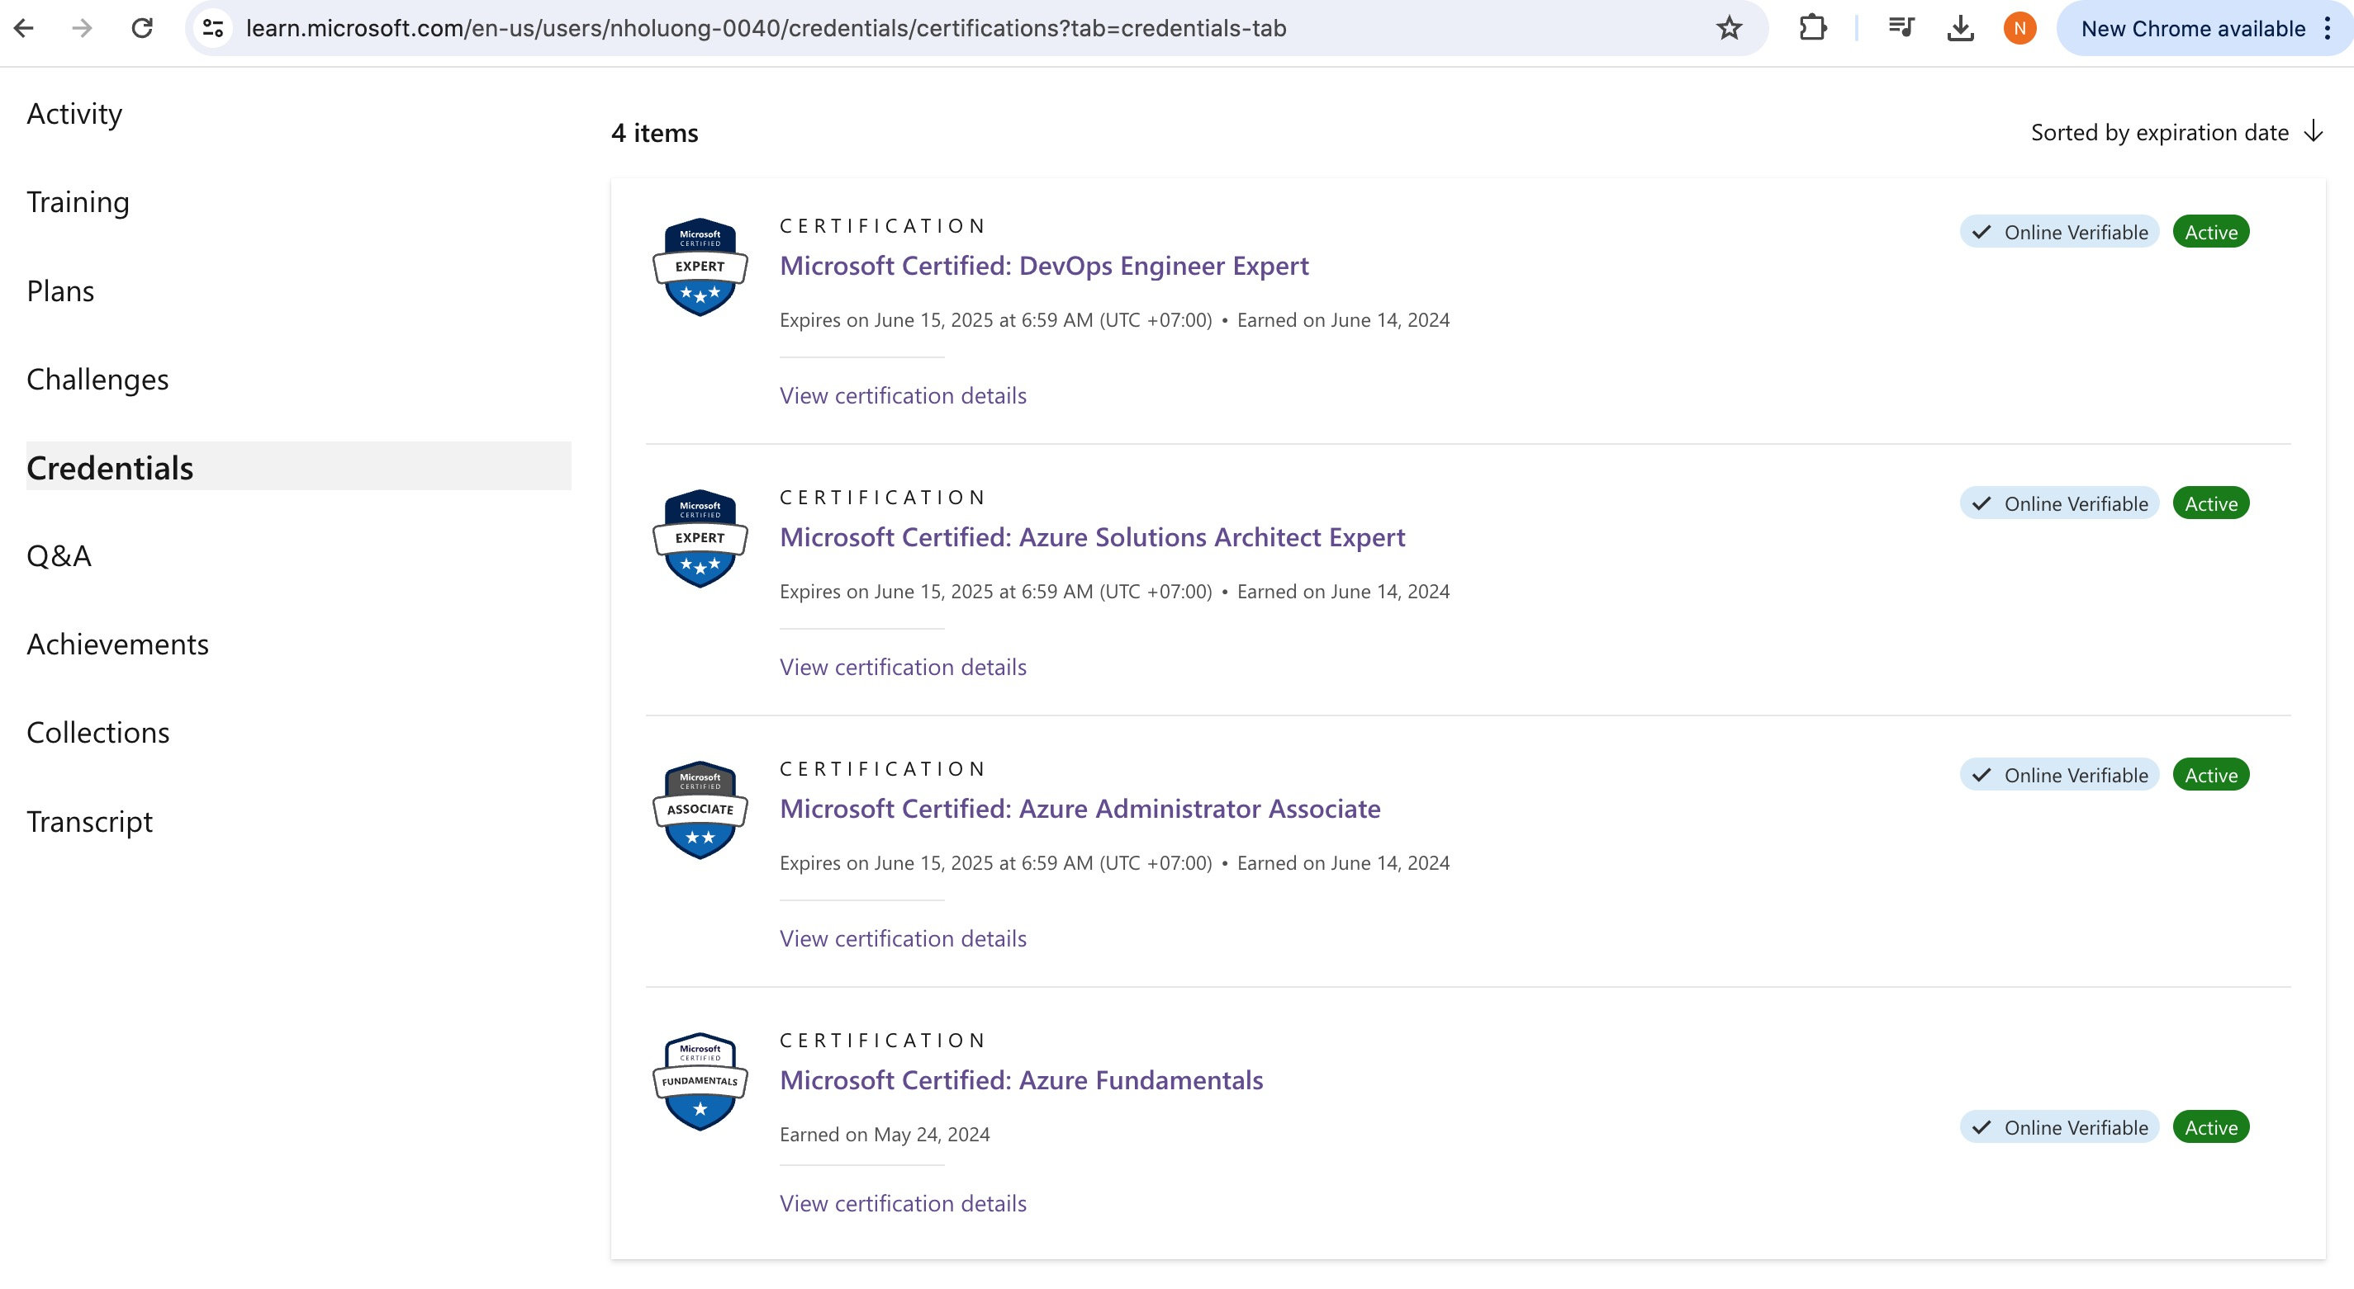
Terraform Associate on Azure Cloud
Author: Nho Luong
Skill: DevOps Engineer Lead
Author: Nho Luong
Skill: DevOps Engineer Lead

Slide 2
Basic Workflow
Providers
Resources
Input
Variables
Data
sources
State Local & Remote
Goal: Learn every Terraform Concept with Practical Demo on Azure Cloud
Workspaces
Provisioners
Terraform
Null Resource
CLI Config
Files
Dynamic Blocks
Local Values
Demo’s
Modules
TerraformCloud
Sentinel
External
Providers
Output
Values
Expressions
Author: Nho Luong
Skill: DevOps Engineer Lead

Slide 3
Azure Cloud
Terraform
Concepts
Terraform
Demo’s
GitHub Step-by-Step Documentation
Author: Nho Luong
Skill: DevOps Engineer Lead

Slide 4
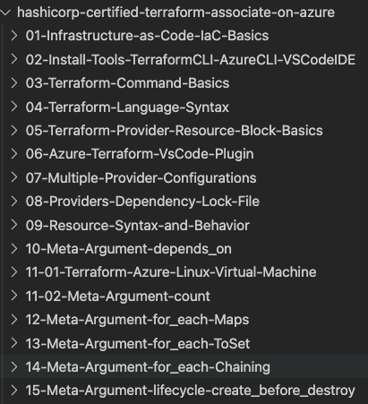
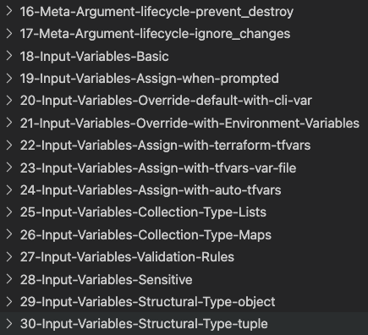
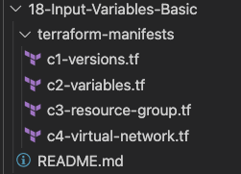
Github Step-by-Step Documentation with Practical Examples for each Concept
Terraform Configuration Files - well kept on Github
Author: Nho Luong
Skill: DevOps Engineer Lead

Slide 5
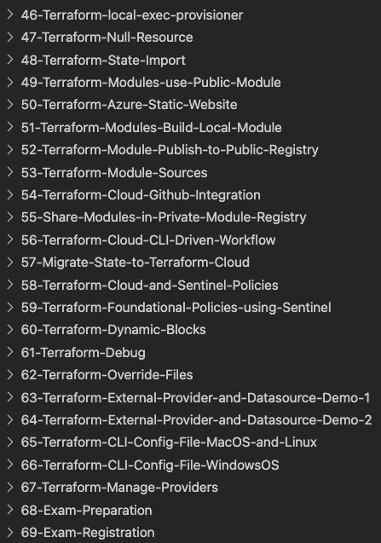
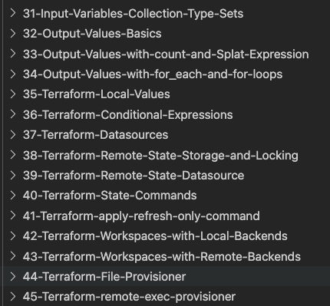
Github Step-by-Step Documentation with Practical Examples for each Concept
Author: Nho Luong
Skill: DevOps Engineer Lead

Slide 6
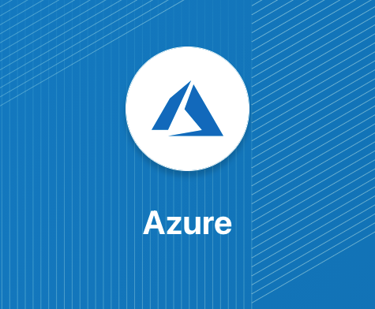






Terraform Providers and Azure Resources used
Azure Resource Group
Azure Virtual Network
Azure Network Interfaces
Azure Linux Virtual Machine
Azure Public IP
Azure Storage Account
Core focus will be on mastering Terraform Concepts with Sample Demo’s
Author: Nho Luong
Skill: DevOps Engineer Lead

Slide 7
GitHub Repositories
Repository Used For | Repository URL
Course Main Repository with step-by-step documentation | https://github.com/nholuongut/terraform-associate-on-azure
Terraform Cloud Demo | https://github.com/nholuongut/terraform-cloud-azure-demo1
Terraform Module Published to Public Registry | https://github.com/nholuongut/terraform-azurerm-staticwebsitepublic
Terraform Module Published to Terraform Cloud Private Registry | https://github.com/nholuongut/terraform-azurerm-staticwebsiteprivate
Terraform Sentinel Policies Demo | https://github.com/nholuongut/terraform-sentinel-policies-azure
Author: Nho Luong
Skill: DevOps Engineer Lead

Slide 8
Terraform Workflow
init
validate
plan
apply
destroy
1
2
3
4
5
terraform init
terraform validate
terraform plan
terraform apply
terraform destroy
Author: Nho Luong
Skill: DevOps Engineer Lead

Slide 9
Terraform Language Basics – Configuration Syntax
Blocks
Arguments
HCL – HashiCorp Language
Terraform
Identifiers
Comments
Author: Nho Luong
Skill: DevOps Engineer Lead

Slide 10
Terraform language uses a limited number of top-level block types, which are blocks that can appear outside of any other block in a TF configuration file.
Terraform
Top-Level
Blocks
Most of Terraform's features are implemented as top-level blocks.
Terraform Block
Input Variables Block
Data Sources Block
Providers Block
Output Values Block
Modules Block
Resources Block
Local Values Block
Fundamental Blocks
Variable Blocks
Calling / Referencing Blocks
Author: Nho Luong
Skill: DevOps Engineer Lead

Slide 11





Terraform Providers
Providers are HEART of Terraform
Every Resource Type (example: Azure Resource Group), is implemented by a Provider
Without Providers Terraform cannot manage any infrastructure.
Terraform Admin
Providers are distributed separately from Terraform and each provider has its own release cycles and Version Numbers
Terraform Registry is publicly available which contains many Terraform Providers for most major Infra Platforms
Local Desktop
1
terraform init
Terraform CLI
Azure Cloud
Download Provider
Terraform Registry
3
terraform plan
4
terraform apply
Azure
APIs
Terraform Azure
Provider
5
terraform destroy
2
terraform validate
Resource Group
Author: Nho Luong
Skill: DevOps Engineer Lead

Slide 12
Terraform
Language Basics
Resource
Meta-Argument
count
Demos
Terraform
Resource Syntax
Resource
Meta-Argument
depends_on
Terraform
Resources
Terraform
Resource Behavior
Resource
Meta-Argument
for_each
Terraform
State
Resource
Meta-Argument
lifecycle
Author: Nho Luong
Skill: DevOps Engineer Lead

Slide 13
Input variables serve as parameters for a Terraform module, allowing aspects of the module to be customized without altering the module's own source code, and allowing modules to be shared between different configurations.
Input Variables - Basics
1
Demos
6
Provide Input Variables using <any-name>.tfvars file with CLI
argument -var-file
Provide Input Variables when prompted during terraform plan or apply
2
7
Provide Input Variables using somefilename.auto.tfvars files
Terraform Input Variables
Override default variable values using CLI argument -var
3
8
Implement complex type constructors like List & Map in Input Variables
Override default variable values using Environment Variables (TF_var_aa)
9
Implement Custom Validation Rules in Variables
4
Provide Input Variables using terraform.tfvars files
5
10
Protect Sensitive Input Variables
13
Input Variables using
Structural Type: Object
11
Input Variables using
Collection Type: set
12
Input Variables using
Structural Type: tuple
Author: Nho Luong
Skill: DevOps Engineer Lead

Slide 14
Output Values – Demos
Demo
Demo
Demo
Basics
Count and Splat Expression
for_each and for loops
Over the process master the for loops in Terraform with Lists and Maps
Author: Nho Luong
Skill: DevOps Engineer Lead

Slide 15
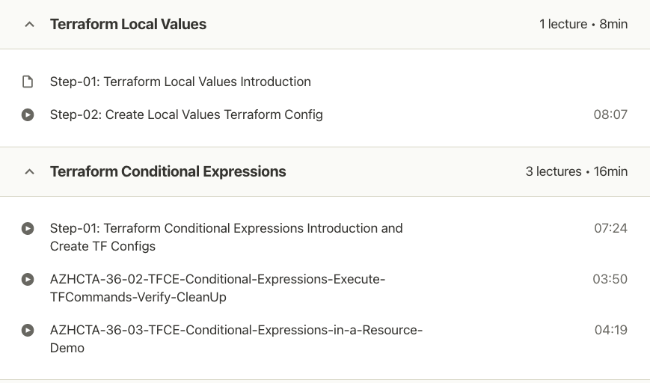
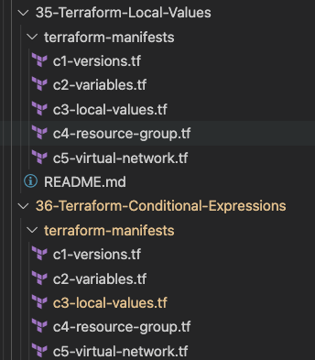
Terraform Local Values - Demos
Author: Nho Luong
Skill: DevOps Engineer Lead

Slide 16
Terraform State
Terraform State Basics
Terraform Desired and Current States
Demos
Terraform Remote State Storage and Locking
Terraform State Commands
Terraform Remote State Datasource
Author: Nho Luong
Skill: DevOps Engineer Lead

Slide 17


Terraform State
Terraform must store state about your managed infrastructure and configuration
Terraform
Admin
This state is used by Terraform to map real world resources to your configuration (.tf files), keep track of metadata, and to improve performance for large infrastructures.
Local Desktop
This state is stored by default in a local file named "terraform.tfstate", but it can also be stored remotely, which works better in a team environment.
1
Azure Cloud
terraform init
Terraform CLI
Download Provider
Terraform Registry
Virtual Network
Subnet
Public IP
Terraform Azure
Provider
4
terraform apply
Azure
APIs
5
terraform destroy
Resource Group
Network Interface
2
terraform validate
3
terraform plan
The primary purpose of Terraform state is to store bindings between objects in a remote system and resource instances declared in your configuration.
Terraform State
File
terraform.tfstate
When Terraform creates a remote object in response to a change of configuration, it will record the identity of that remote object against a particular resource instance, and then potentially update or delete that object in response to future configuration changes.
Author: Nho Luong
Skill: DevOps Engineer Lead

Slide 18
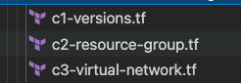
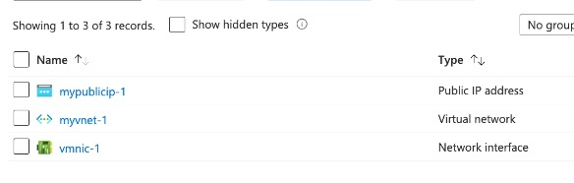
Desired & Current Terraform States
Terraform Configuration Files
Real World Resources
terraform.tfstate
Desired State
Current State
Author: Nho Luong
Skill: DevOps Engineer Lead

Slide 19
What is Terraform Backend ?
Backends are responsible for storing state and providing an API for state locking.
Terraform State Storage
Terraform State Locking
Azure Storage Account
Author: Nho Luong
Skill: DevOps Engineer Lead

Slide 20








Local State File
Remote State File
Admin1
Admin2
Admin3
Multiple Team members
cannot update the infrastructure as they don’t have access to State File
Using Terraform Backend concept we can use Azure SA as the shared storage for State Files
Admin1
Admin2
Admin3
Admin1
Desktop
Admin2
Desktop
Admin3
Desktop
This means we need store the state file in a shared location.
If two team members are running Terraform at the same time, you may run into race conditions as multiple Terraform processes make concurrent updates to the state files, leading to conflicts, data loss, and state file corruption.
Admin1
Desktop
Azure
Storage Account
terraform.tfstate
terraform.tfstate
Azure VM
Instance
Azure VM
Instance
Azure Cloud
State Locking
Azure Cloud
Author: Nho Luong
Skill: DevOps Engineer Lead

Slide 21
Terraform Remote State File with State Locking
Admin1
Admin2
Admin3
Not all backends support State Locking. Azure Storage Account supports State Locking
State locking happens automatically on all operations that could write state.
Admin1
Desktop
Admin2
Desktop
Admin3
Desktop
If state locking fails, Terraform will not continue.
You can disable state locking for most commands with the -lock flag but it is not recommended.
Azure Storage Account
terraform.tfstate
If acquiring the lock is taking longer than expected, Terraform will output a status message.
If Terraform doesn't output a message, state locking is still occurring if your backend supports it.
Azure VM
Instance
Terraform has a force-unlock command to manually unlock the state if unlocking failed.
Azure Cloud
Author: Nho Luong
Skill: DevOps Engineer Lead

Slide 22
Terraform Commands – State Perspective
terraform show
terraform
force-unlock
terraform apply refresh-only
Terraform
Commands
terraform taint
terraform plan
terraform untaint
terraform state
terraform
apply target
Author: Nho Luong
Skill: DevOps Engineer Lead

Slide 23
Terraform Remote State Datasource
The terraform_remote_state data source retrieves the root module output values from some other Terraform configuration, using the latest state snapshot from the remote backend.
Project-1
How multiple Terraform Projects communicate to each other? Very Important in Real-World
Project-2
Azure Resource Group
Virtual Network
Azure Linux Virtual Machine
terraform_remote_state data source
project-1/terraform.tfstate
project-2/terraform.tfstate
Author: Nho Luong
Skill: DevOps Engineer Lead

Slide 24
Types of Provisioners
File Provisioner
Provisioner Types
remote-exec Provisioner
Null Resource
local-exec Provisioner
Author: Nho Luong
Skill: DevOps Engineer Lead

Slide 25
Terraform Modules
Demos
Author: Nho Luong
Skill: DevOps Engineer Lead

Slide 26
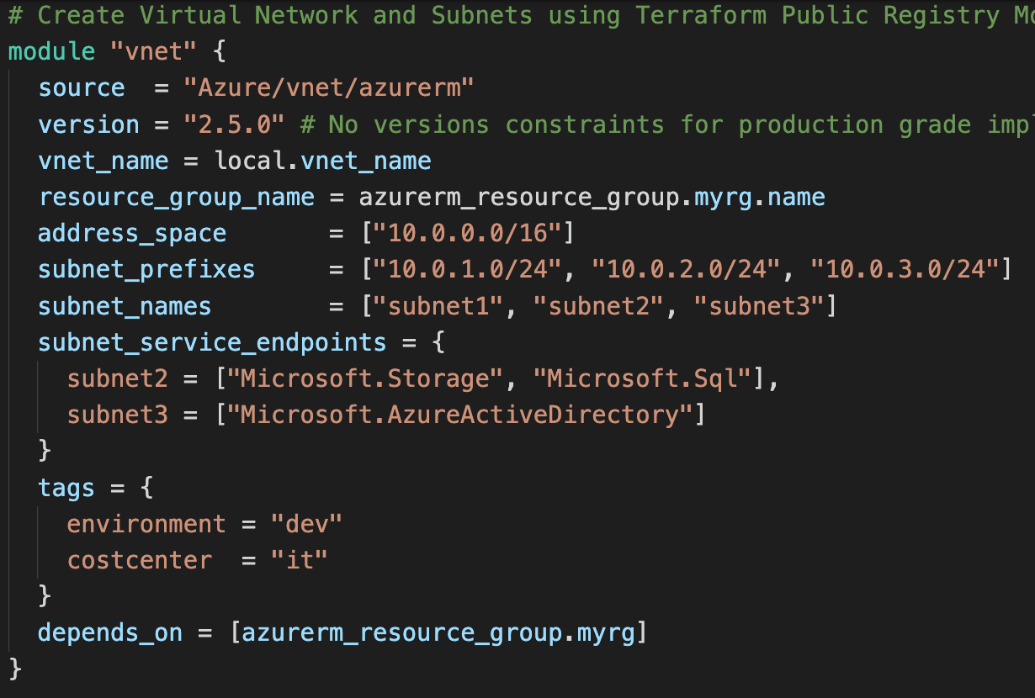
Terraform Registry – Use Publicly Available Modules
The Terraform Registry hosts a broad collection of publicly available Terraform modules for configuring many kinds of common infrastructure.
Demo
These modules are free to use, and Terraform can download them automatically if you specify the appropriate source and version in a module call block.
Author: Nho Luong
Skill: DevOps Engineer Lead

Slide 27
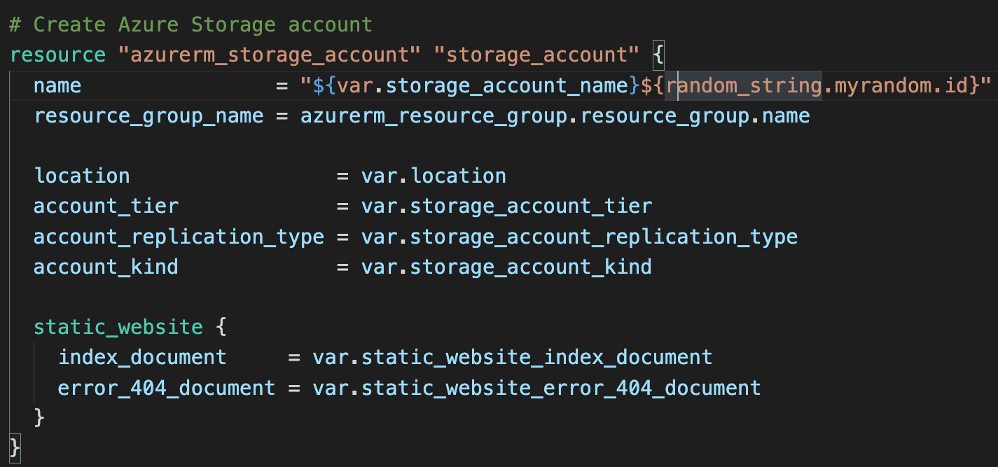
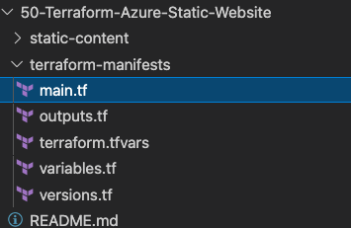
Build manually and then automate using Terraform
1. Build a Static Website using Azure manually using Azure Portal.
2. Automate it using Terraform Resources
Demo
Author: Nho Luong
Skill: DevOps Engineer Lead

Slide 28
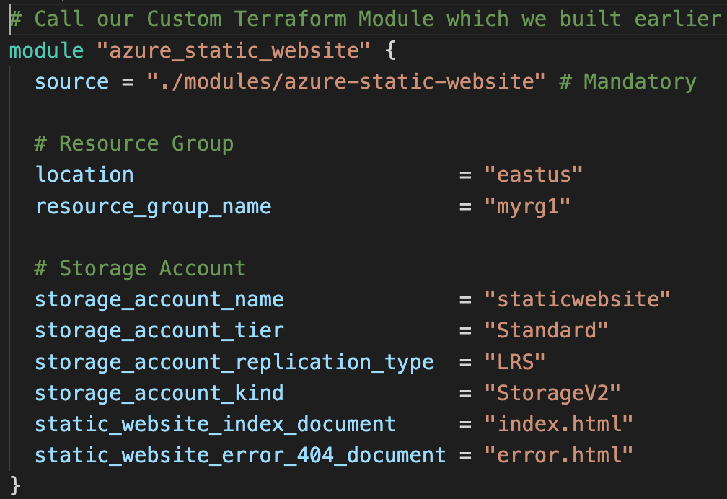
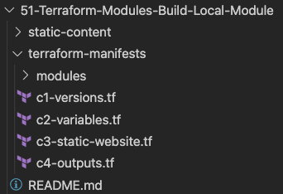
Build a Local Terraform Module
Demo
Build a Local Terraform Module and call it from Root Module and Test
Author: Nho Luong
Skill: DevOps Engineer Lead

Slide 29
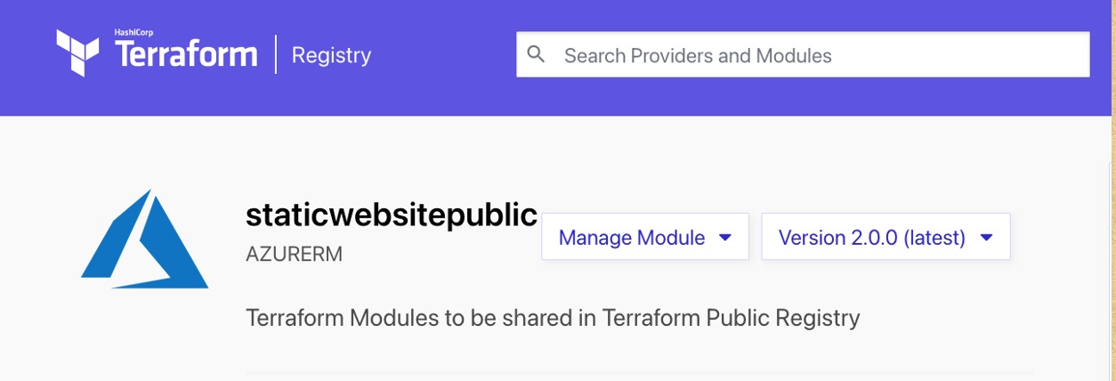
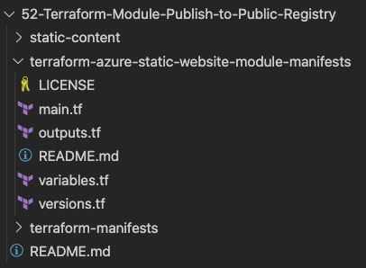
Publish to Public Terraform Registry
Demo
Publish to Public Terraform Registry and Access it from Public Registry and Test.
Author: Nho Luong
Skill: DevOps Engineer Lead

Slide 30
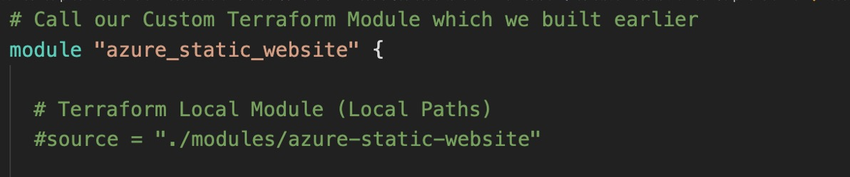
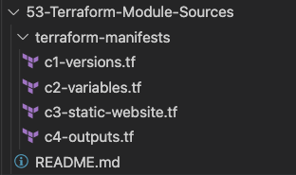
Use various Module Sources
Demo
In addition to Terraform Public and Private Registry use various module sources.
Author: Nho Luong
Skill: DevOps Engineer Lead

Slide 31
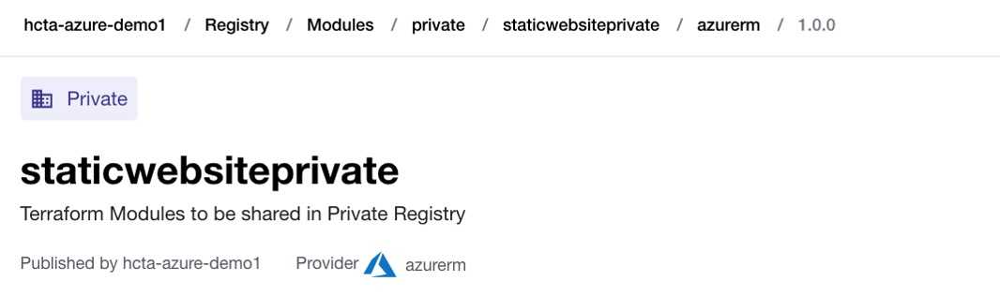
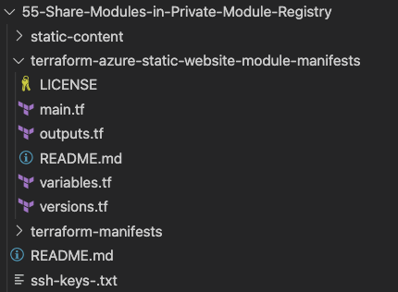
Private Module Registry in Terraform Cloud & Enterprise
Members of your organization might produce modules specifically crafted for your own infrastructure needs.
Terraform Cloud and Terraform Enterprise both include a private module registry for sharing modules internally within your organization.
Demo
Author: Nho Luong
Skill: DevOps Engineer Lead

Slide 32
Terraform Cloud & Sentinel Policies
Demos
Author: Nho Luong
Skill: DevOps Engineer Lead

Slide 33


Terraform VCS-Driven Workflow
Terraform CLI-Driven Workflow
Check-in TF Files
Github
terraform plan
Local
Desktop
terraform apply
Developer
Developer
Triggers Terraform
Runs
Runs on Terraform Cloud
Terraform
Cloud
Terraform
Cloud
Author: Nho Luong
Skill: DevOps Engineer Lead

Slide 34
Publish Private Module Registry in Terraform Cloud
Check-in Private Module
Files
Github
Developer
Integrate it in
TF Cloud Modules
Terraform
Cloud
Author: Nho Luong
Skill: DevOps Engineer Lead

Slide 35
Terraform Cloud & Sentinel
Basic Policies
Cost Control
Policies
CIS
Policies
Author: Nho Luong
Skill: DevOps Engineer Lead

Slide 36
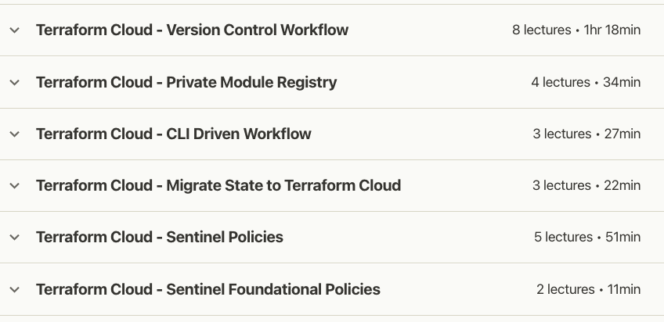
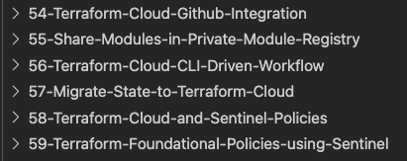
Terraform Cloud
Author: Nho Luong
Skill: DevOps Engineer Lead

Slide 37
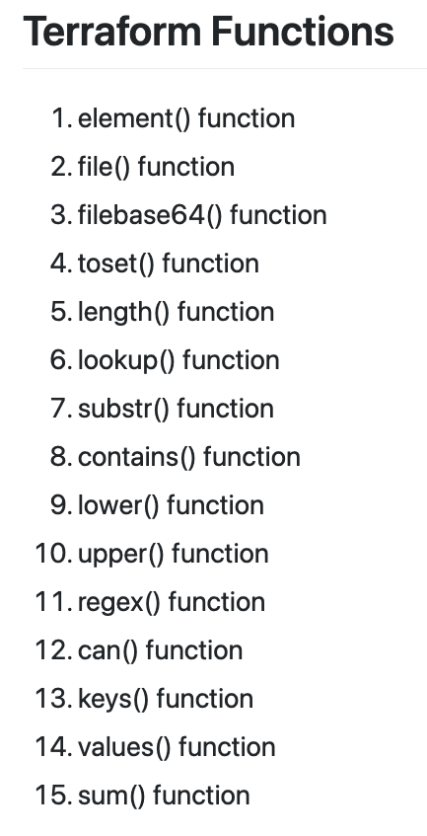
Terraform Functions
Author: Nho Luong
Skill: DevOps Engineer Lead

Slide 38
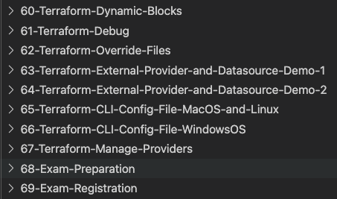
Additional Terraform Concepts
Author: Nho Luong
Skill: DevOps Engineer Lead

Slide 39
Terraform
Infrastructure as Code
IaC
Author: Nho Luong
Skill: DevOps Engineer Lead

Slide 40
What is Infrastructure as Code ?
Author: Nho Luong
Skill: DevOps Engineer Lead

Slide 41
Traditional Way of Managing Infrastructure
Admin-1
Admin-1
Admin-2
Admin-2
Admin-2
Documentation
Dev
QA
Staging
Production
Disaster
Recovery
This is fullflow infrastructure management process
Author: Nho Luong
Skill: DevOps Engineer Lead

Slide 42
Traditional Way of Managing Infrastructure
Admin-1
Admin-1
Admin-2
Admin-2
Admin-2
Documentation
(Steps Missing)
Dev
QA
Staging
Production
Disaster
Recovery
No CI
Delays
Issues
Outages
Not-in-Sync
Many Problems at many places in manual process
Author: Nho Luong
Skill: DevOps Engineer Lead

Slide 43

Traditional Way of Managing Infrastructure
Admin-1
Admin-1
Admin-2
Admin-2
Admin-2
Documentation
Dev
QA
Staging
Production
Disaster
Recovery
Dev
QA
Staging
Production
Disaster
Recovery
Admin-3
Admin-3
Admin-4
Admin-4
Admin-4
Documentation
Infrastructure scalability – Workforce need to be increased to meet the timelines
Author: Nho Luong
Skill: DevOps Engineer Lead

Slide 44
Traditional Way of Managing Infrastructure
Prod-1
Prod-2
Prod-3
Prod-4
Scale Up
Prod-1
Prod-2
Scale Down
On-Demand Scale-Up and Scale-Down is not an option
Author: Nho Luong
Skill: DevOps Engineer Lead

Slide 45


Manage using IaC with Terraform
5 Days
Admin-1
Github
DevOps / CI CD for IaC
Check-In TF Code
Triggers
TF Runs
Terraform
Cloud
Scale-Up and Scale-Down On-Demand
Creates Infra
Dev
QA
Staging
Production
Disaster
Recovery
One-Time
Work
Re-Use
Templates
Quick & Fast
Reliable
Tracked for Audit
Provisioning environments will be in minutes or seconds
Author: Nho Luong
Skill: DevOps Engineer Lead

Slide 46
Manage using IaC with Terraform
Visibility
IaC serves as a very clear reference of what resources we created, and what their settings are. We don’t have to navigate to the web console to check the parameters.
Stability
If you accidentally change the wrong setting or delete the wrong resource in the web console you can break things. IaC helps solve this, especially when it is combined with version control, such as Git.
Scalability
With IaC we can write it once and then reuse it many times. This means that one well written template can be used as the basis for multiple services, in multiple regions around the world, making it much easier to horizontally scale.
Security
Once again IaC gives you a unified template for how to deploy our architecture. If we create one well secured architecture we can reuse it multiple times, and know that each deployed version is following the same settings.
Audit
Terraform not only creates resources it also maintains the record of what is created in real world cloud environments using its State files.
Author: Nho Luong
Skill: DevOps Engineer Lead

Slide 47
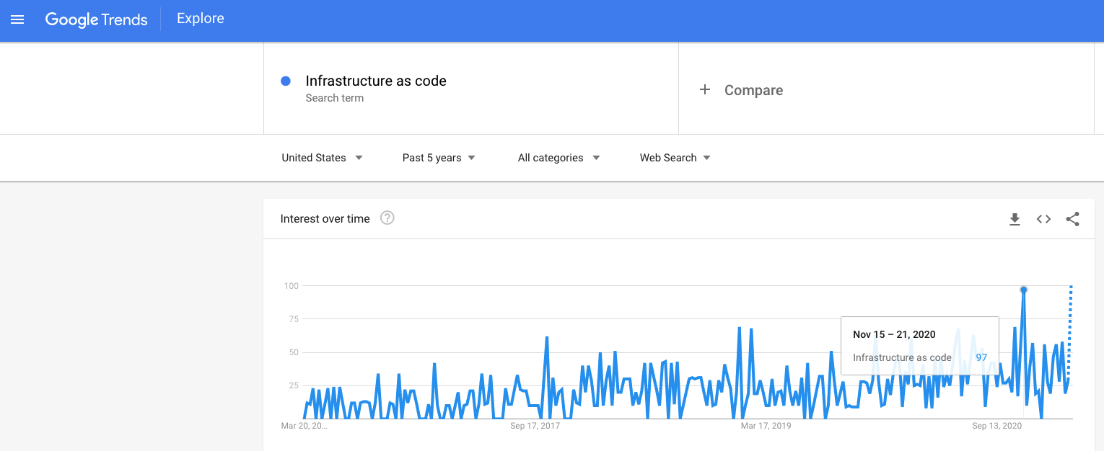
Google Trends – Past 5 Years
Author: Nho Luong
Skill: DevOps Engineer Lead

Slide 48
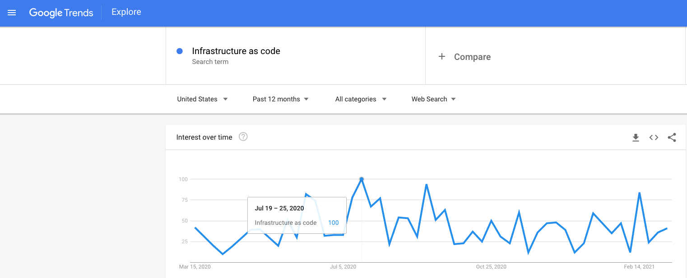
Google Trends – Past 1 Year
Author: Nho Luong
Skill: DevOps Engineer Lead

Slide 49

Terraform
Installation
Author: Nho Luong
Skill: DevOps Engineer Lead

Slide 50
Terraform Installation
Terraform CLI
Azure CLI
VS Code Editor
Terraform plugin for VS Code
GIT Client
Mac OS
Windows OS
Linux OS
Author: Nho Luong
Skill: DevOps Engineer Lead

Slide 51
Terraform
Command Basics
Author: Nho Luong
Skill: DevOps Engineer Lead

Slide 52
Terraform Workflow
init
validate
plan
apply
destroy
1
2
3
4
5
terraform init
terraform validate
terraform plan
terraform apply
terraform destroy
Author: Nho Luong
Skill: DevOps Engineer Lead

Slide 53
Terraform Workflow
init
validate
plan
apply
destroy
1
2
3
4
5
Used to Initialize a working directory containing terraform config files
This is the first command that should be run after writing a new Terraform configuration
Downloads Providers
Validates the terraform configurations files in that respective directory to ensure they are syntactically valid and internally consistent.
Creates an execution plan
Terraform performs a refresh and determines what actions are necessary to achieve the desired state specified in configuration files
Used to apply the changes required to reach the desired state of the configuration.
By default, apply scans the current directory for the configuration and applies the changes appropriately.
Used to destroy the Terraform-managed infrastructure
This will ask for confirmation before destroying.
Author: Nho Luong
Skill: DevOps Engineer Lead

Slide 54
Terraform
Language Basics
Theoretical but Very Important
Author: Nho Luong
Skill: DevOps Engineer Lead

Slide 55
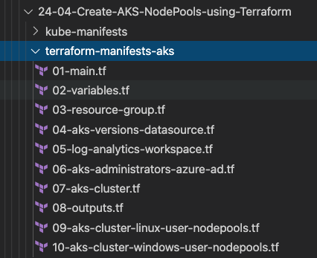
Terraform Language Basics – Files
Terraform Working Directory
Code in the Terraform language is stored in plain text files with the .tf file extension.
There is also a JSON-based variant of the language that is named with the .tf.json file extension.
We can call the files containing terraform code as Terraform Configuration Files or Terraform Manifests
Terraform Configuration Files ending with .tf as extension
Author: Nho Luong
Skill: DevOps Engineer Lead

Slide 56
Terraform Language Basics – Configuration Syntax
Blocks
Arguments
HCL – HashiCorp Language
Terraform
Identifiers
Comments
Author: Nho Luong
Skill: DevOps Engineer Lead

Slide 57
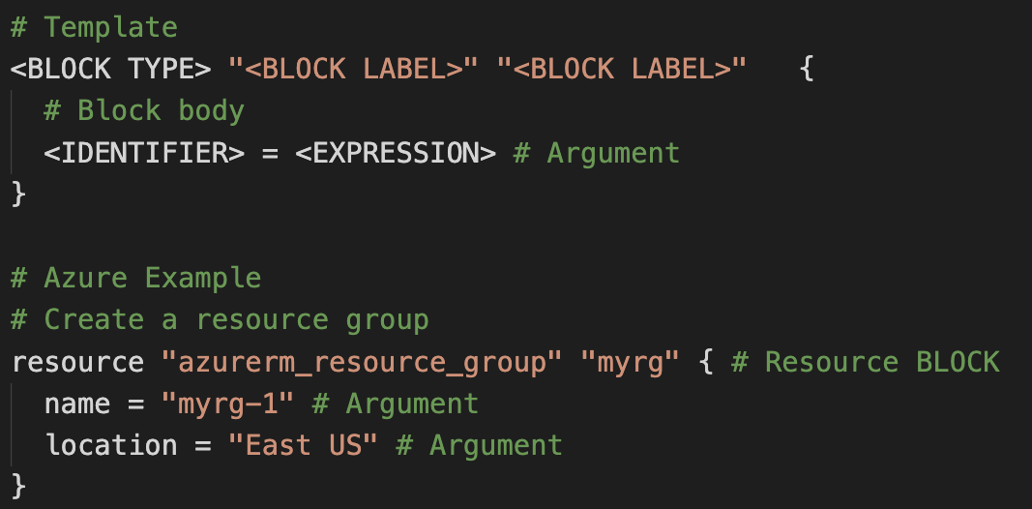
Terraform Language Basics – Configuration Syntax
Block Labels
Block Type
Based on Block Type block labels will be 1 or 2
Example: Resource – 2 labels
Variables – 1 label
Top Level & Block inside Blocks
Top Level Blocks: resource, provider
Arguments
Block Inside Block: provisioners, resource specific blocks like tags
Author: Nho Luong
Skill: DevOps Engineer Lead

Slide 58
Terraform Language Basics – Configuration Syntax
Argument Name
[or]
Identifier
Argument Value
[or]
Expression
Author: Nho Luong
Skill: DevOps Engineer Lead

Slide 59
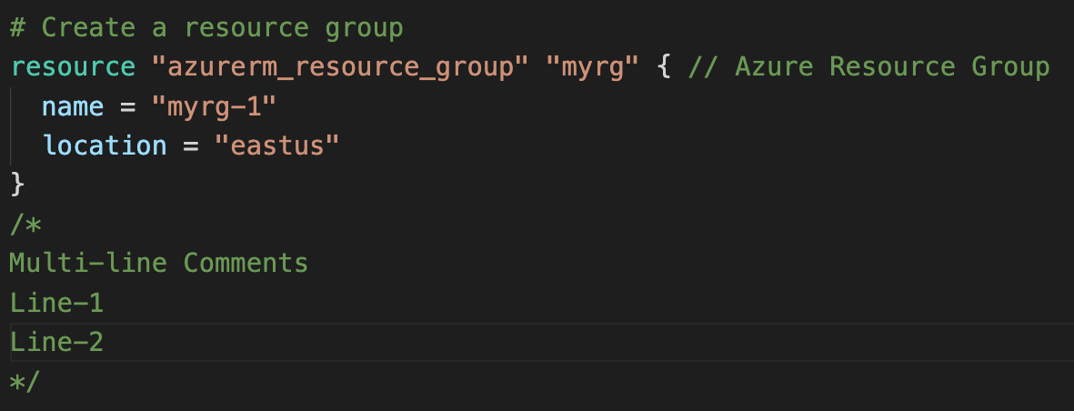
Terraform Language Basics – Configuration Syntax
Single Line Comments with # or //
Multi-line comment
Author: Nho Luong
Skill: DevOps Engineer Lead

Slide 60
Terraform language uses a limited number of top-level block types, which are blocks that can appear outside of any other block in a TF configuration file.
Terraform
Top-Level
Blocks
Most of Terraform's features are implemented as top-level blocks.
Terraform Block
Input Variables Block
Data Sources Block
Providers Block
Output Values Block
Modules Block
Resources Block
Local Values Block
Fundamental Blocks
Variable Blocks
Calling / Referencing Blocks
Author: Nho Luong
Skill: DevOps Engineer Lead

Slide 61
Terraform
Fundamental Blocks
Terraform, Provider, Resources
Author: Nho Luong
Skill: DevOps Engineer Lead

Slide 62
Terraform Basic Blocks
Terraform
Block
Provider
Block
Resource
Block
Special block used to configure some behaviors
HEART of Terraform
Each Resource Block describes one or more Infrastructure Objects
Specifying a required Terraform CLI Version
Terraform relies on providers to interact with Remote Systems
Resource Syntax:
How to declare Resources?
Specifying Provider Requirements & Versions
Declare providers for Terraform to install providers & use them
Resource Behavior: How Terraform handles resource declarations?
Configuring a Terraform Backend (Terraform State)
Provider configurations belong to Root Module
Provisioners: We can configure Resource post-creation actions
Author: Nho Luong
Skill: DevOps Engineer Lead

Slide 63
Terraform
Block
Author: Nho Luong
Skill: DevOps Engineer Lead

Slide 64
Terraform Block
This block can be called in 3 ways. All means the same.
Terraform Block
Terraform Settings Block
Terraform Configuration Block
Each terraform block can contain a number of settings related to Terraform's behavior.
Within a terraform block, only constant values can be used; arguments may not refer to named objects such as resources, input variables, etc, and may not use any of the Terraform language built-in functions.
Author: Nho Luong
Skill: DevOps Engineer Lead

Slide 65
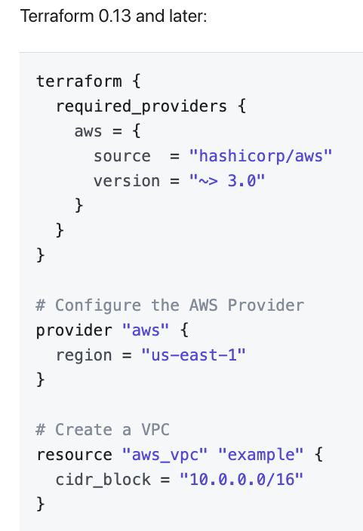
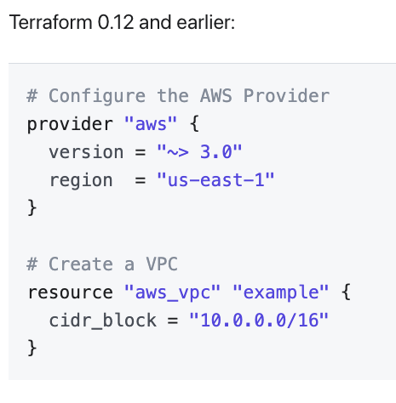
Terraform Block from 0.13 onwards
Author: Nho Luong
Skill: DevOps Engineer Lead

Slide 66
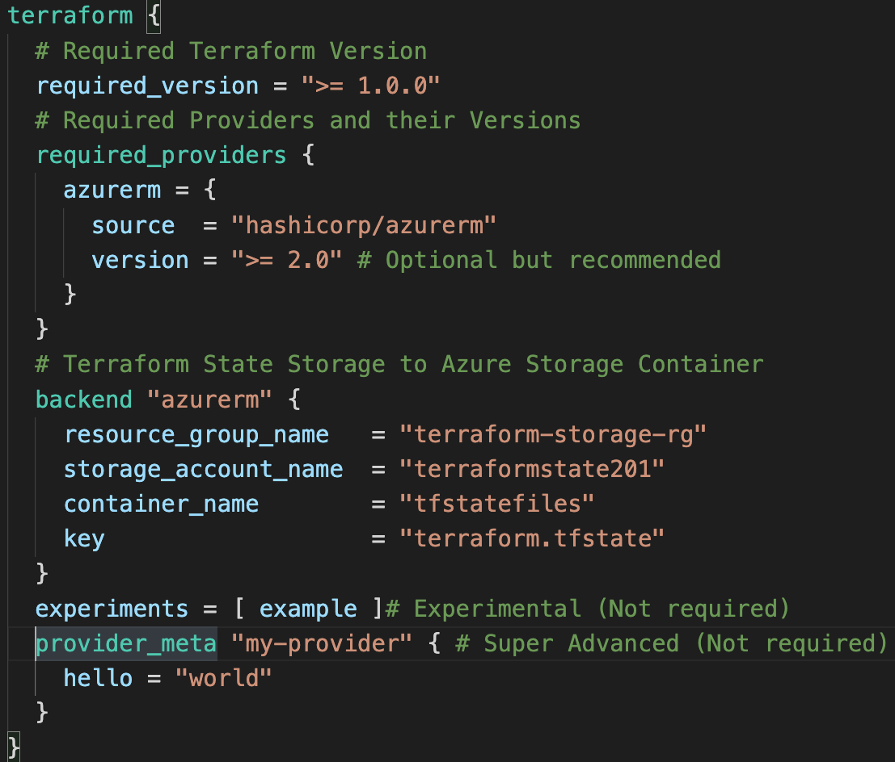
Terraform Block
Required Terraform Version
Provider Requirements
Terraform Block
Terraform Backend
Experimental Language Features
Passing Metadata to
Providers
Author: Nho Luong
Skill: DevOps Engineer Lead

Slide 67
Terraform
Providers
Author: Nho Luong
Skill: DevOps Engineer Lead

Slide 68
Terraform Providers
Providers are HEART of Terraform
Every Resource Type (example: Azure Resource Group), is implemented by a Provider
Without Providers Terraform cannot manage any infrastructure.
Terraform Admin
Providers are distributed separately from Terraform and each provider has its own release cycles and Version Numbers
Terraform Registry is publicly available which contains many Terraform Providers for most major Infra Platforms
Local Desktop
1
terraform init
Terraform CLI
Azure Cloud
Download Provider
Terraform Registry
3
terraform plan
4
terraform apply
Azure
APIs
Terraform Azure
Provider
5
terraform destroy
2
terraform validate
Resource Group
Author: Nho Luong
Skill: DevOps Engineer Lead

Slide 69
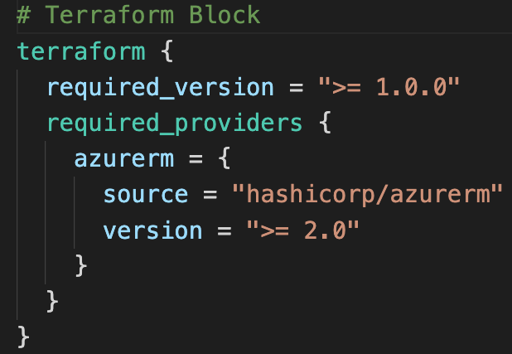
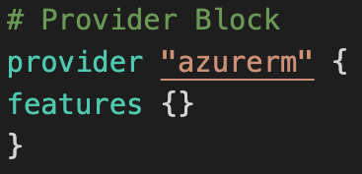
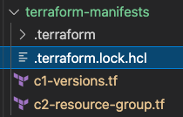
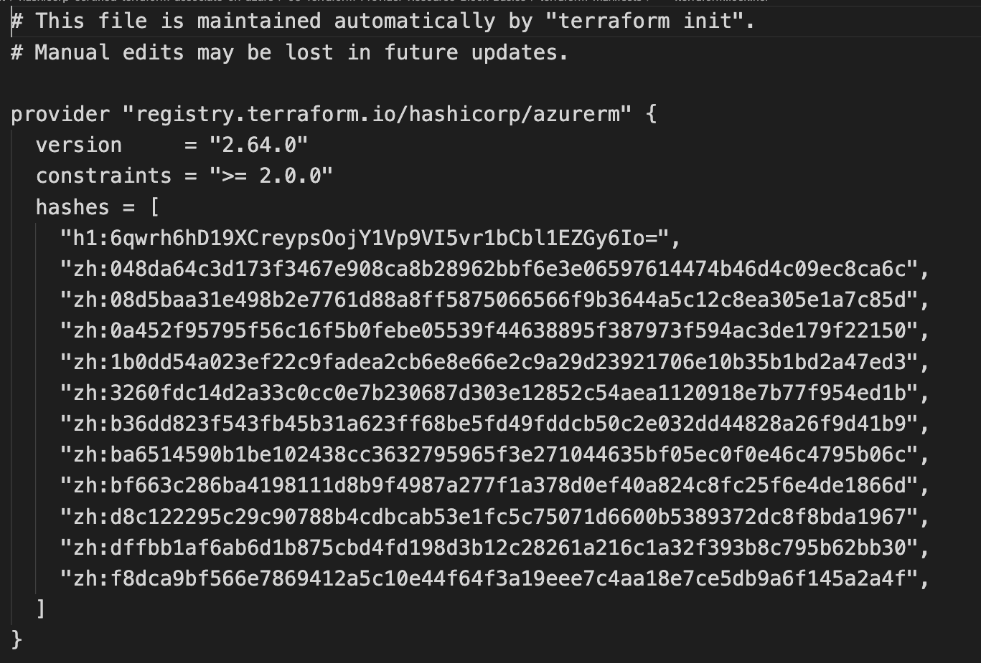
Terraform
Providers
Provider Requirements
Provider Configuration
Dependency Lock File
Author: Nho Luong
Skill: DevOps Engineer Lead

Slide 70
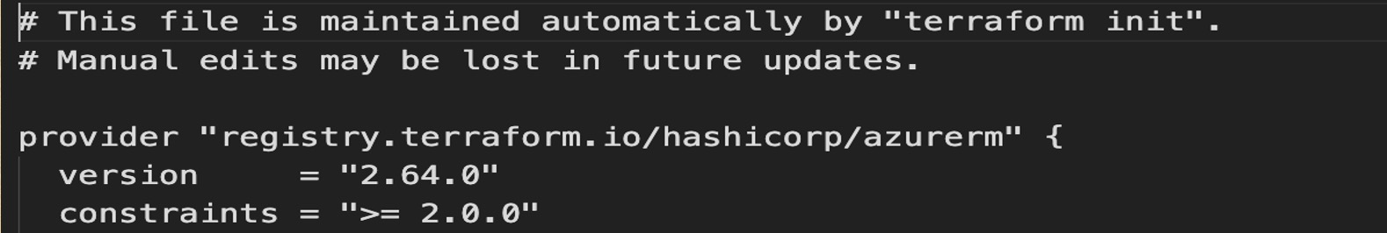
Dependency Lock File
Author: Nho Luong
Skill: DevOps Engineer Lead

Slide 71
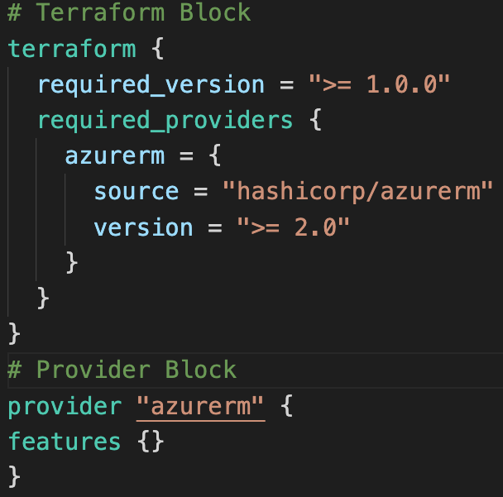
Required Providers
Local Names
Local Names are Module specific and should be unique per-module
Terraform configurations always refer to local name of provider outside required_provider block
Users of a provider can choose any local name for it (myazure, azure1, azure2).
Recommended way of choosing local name is to use preferred local name of that provider (For Azure Provider: hashicorp/azurerm, preferred local name is azurerm)
Source
It is the primary location where we can download the Terraform Provider
Source addresses consist of three parts delimited by slashes (/)
[<HOSTNAME>/]<NAMESPACE>/<TYPE>
registry.terraform.io/hashicorp/azurerm
Registry Name is optional as default is going to be Terraform Public Registry
Author: Nho Luong
Skill: DevOps Engineer Lead

Slide 72




Terraform Registry
Terraform Provider Registry
Providers
registry.terraform.io
Modules
Provider Badges
These are owned and maintained by HashiCorp
Provider Documentation
These are owned and maintained by third-party technology partners. HashiCorp has verified the authenticity of the Provider’s publisher
Community providers are published to the Terraform Registry by individual maintainers, groups of maintainers, or other members of the Terraform community.
Archived Providers are Official or Verified Providers that are no longer maintained by HashiCorp or the community.
Author: Nho Luong
Skill: DevOps Engineer Lead

Slide 73
Terraform
Multiple Providers
Author: Nho Luong
Skill: DevOps Engineer Lead

Slide 74
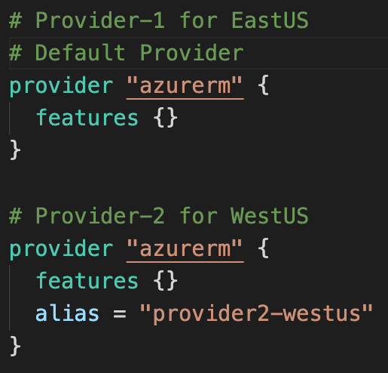
Multiple Providers
We can define multiple configurations for the same provider, and select which one to use on a per-resource or per-module basis.
The primary reason for this is to support multiple regions for a cloud platform
Author: Nho Luong
Skill: DevOps Engineer Lead

Slide 75
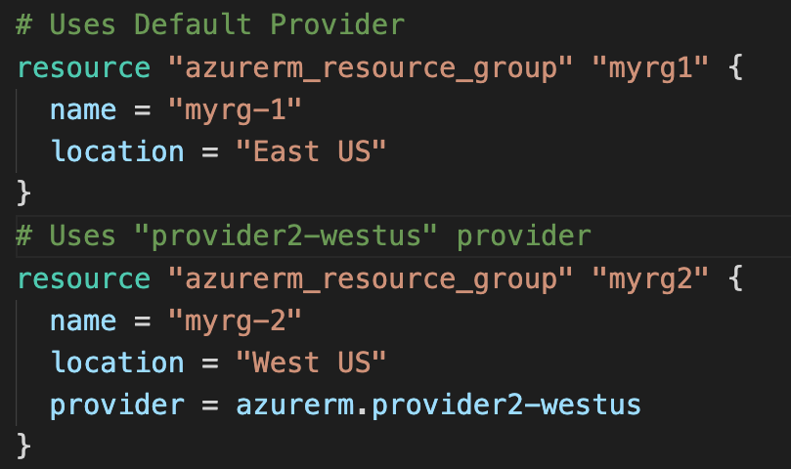
Multiple Providers
We can use the alternate provider in a resource, data or module by referencing it as <PROVIDER NAME>.<ALIAS>
Author: Nho Luong
Skill: DevOps Engineer Lead

Slide 76
Terraform
Dependency Lock File
Author: Nho Luong
Skill: DevOps Engineer Lead

Slide 77
Dependency Lock File
New feature added from Terraform v0.14 & later
Terraform
Terraform configuration refers to two different kinds of external dependency that come from outside of its own codebase
Providers
Modules
Version Constraints within the configuration itself determine which versions of dependencies are potentially compatible
Dependency Lock File: After selecting a specific version of each dependency using Version Constraints Terraform remembers the decisions it made in a dependency lock file so that it can (by default) make the same decisions again in future.
Location of Lock File: Current Working Directory
Very Important: Lock File currently tracks only Provider Dependencies. For modules continue to use exact version constraint to ensure that Terraform will always select the same module version.
Checksum Verification: Terraform will also verify that each package it installs matches at least one of the checksums it previously recorded in the lock file, if any, returning an error if none of the checksums match
Author: Nho Luong
Skill: DevOps Engineer Lead

Slide 78
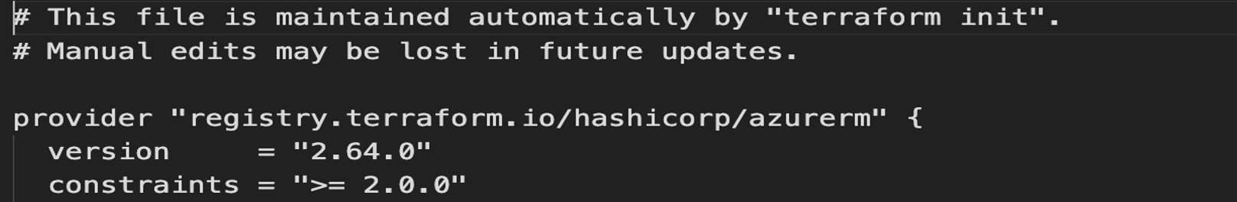
Dependency Lock File
Author: Nho Luong
Skill: DevOps Engineer Lead

Slide 79
Importance of Dependency Lock File
If Terraform did not find a lock file, it would download the latest versions of the providers that fulfill the version constraints you defined in the required_providers block inside Terraform Settings Block.
If we have lock file, the lock file causes Terraform to always install the same provider version, ensuring that runs across your team or remote sessions will be consistent.
Author: Nho Luong
Skill: DevOps Engineer Lead

Slide 80
Terraform
Resources
Introduction
Author: Nho Luong
Skill: DevOps Engineer Lead

Slide 81
Terraform
Language Basics
Resource
Meta-Argument
count
Terraform
Resource Syntax
Resource
Meta-Argument
depends_on
Terraform
Resources
Terraform
Resource Behavior
Resource
Meta-Argument
for_each
Terraform
State
Resource
Meta-Argument
lifecycle
Author: Nho Luong
Skill: DevOps Engineer Lead

Slide 82
Terraform
Resource Syntax
Author: Nho Luong
Skill: DevOps Engineer Lead

Slide 83
Terraform Language Basics – Configuration Syntax
Block Labels
Block Type
Based on Block Type block labels will be 1 or 2
Example: Resource – 2 labels
Variables – 1 label
Top Level & Block inside Blocks
Top Level Blocks: resource, provider
Arguments
Block Inside Block: provisioners, resource specific blocks like tags
Author: Nho Luong
Skill: DevOps Engineer Lead

Slide 84
Terraform Language Basics – Configuration Syntax
Argument Name
[or]
Identifier
Argument Value
[or]
Expression
Author: Nho Luong
Skill: DevOps Engineer Lead

Slide 85
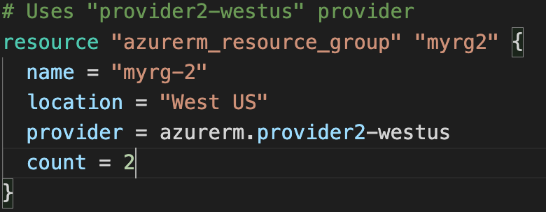
Resource Syntax
Resource Type: It determines the kind of infrastructure object it manages and what arguments and other attributes the resource supports.
Resource Local Name: It is used to refer to this resource from elsewhere in the same Terraform module, but has no significance outside that module's scope.
The resource type and name together serve as an identifier for a given resource and so must be unique within a module
Meta-Arguments: Can be used with any resource to change the behavior of resources
Resource Arguments: Will be specific to resource type. Argument Values can make use of Expressions or other Terraform Dynamic Language Features
Author: Nho Luong
Skill: DevOps Engineer Lead

Slide 86
Terraform
Resource Behavior
Author: Nho Luong
Skill: DevOps Engineer Lead

Slide 87
Resource Behavior
Create Resource
Create resources that exist in the configuration but are not associated with a real infrastructure object in the state.
Destroy Resource
Destroy resources that exist in the state but no longer exist in the configuration.
Terraform Resource
Update in-place Resources
Update in-place resources whose arguments have changed.
Destroy and re-create
Destroy and re-create resources whose arguments have changed but which cannot be updated in-place due to remote API limitations.
Terraform State
Author: Nho Luong
Skill: DevOps Engineer Lead

Slide 88
Terraform
State
Author: Nho Luong
Skill: DevOps Engineer Lead

Slide 89
Terraform State
Terraform must store state about your managed infrastructure and configuration
Terraform
Admin
This state is used by Terraform to map real world resources to your configuration (.tf files), keep track of metadata, and to improve performance for large infrastructures.
Local Desktop
This state is stored by default in a local file named "terraform.tfstate", but it can also be stored remotely, which works better in a team environment.
1
Azure Cloud
terraform init
Terraform CLI
Download Provider
Terraform Registry
Virtual Network
Subnet
Public IP
Terraform Azure
Provider
4
terraform apply
Azure
APIs
5
terraform destroy
Resource Group
Network Interface
2
terraform validate
3
terraform plan
The primary purpose of Terraform state is to store bindings between objects in a remote system and resource instances declared in your configuration.
Terraform State
File
terraform.tfstate
When Terraform creates a remote object in response to a change of configuration, it will record the identity of that remote object against a particular resource instance, and then potentially update or delete that object in response to future configuration changes.
Author: Nho Luong
Skill: DevOps Engineer Lead

Slide 90
Terraform
State
Desired & Current
Author: Nho Luong
Skill: DevOps Engineer Lead

Slide 91
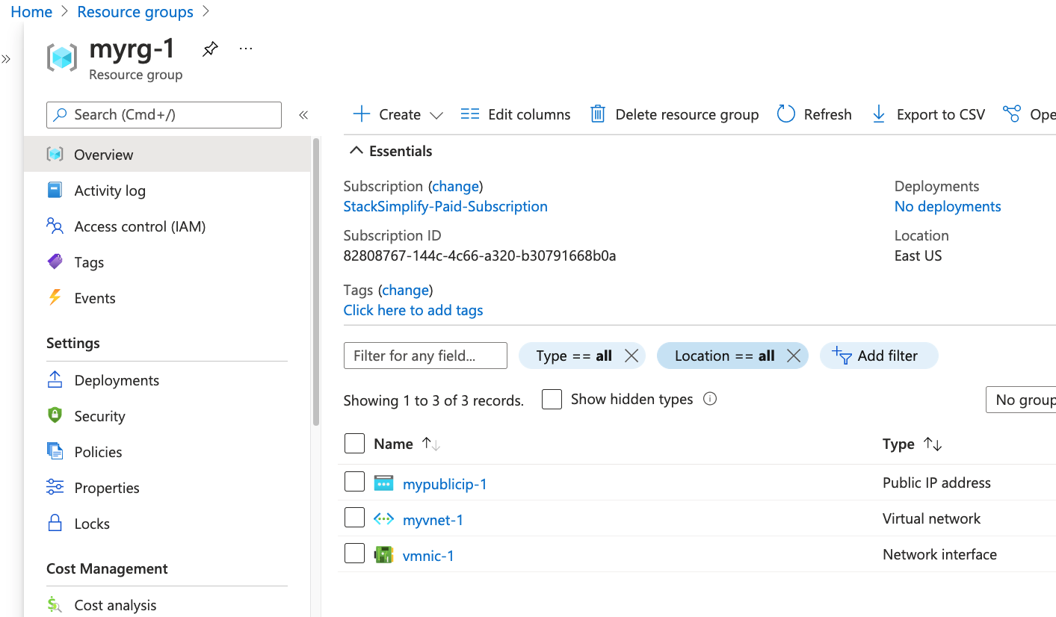
Desired & Current Terraform States
Terraform Configuration Files
Real World Resources
terraform.tfstate
Desired State
Current State
Author: Nho Luong
Skill: DevOps Engineer Lead

Slide 92
Terraform
Resource
Meta-Arguments
Author: Nho Luong
Skill: DevOps Engineer Lead

Slide 93
Resource Meta-Arguments
depends_on
count
Terraform Resources
Meta-Arguments
for_each
provider
Meta-Arguments can be used with any resource type to change the behavior of resources.
lifecycle
Provisioners & Connections
Author: Nho Luong
Skill: DevOps Engineer Lead

Slide 94
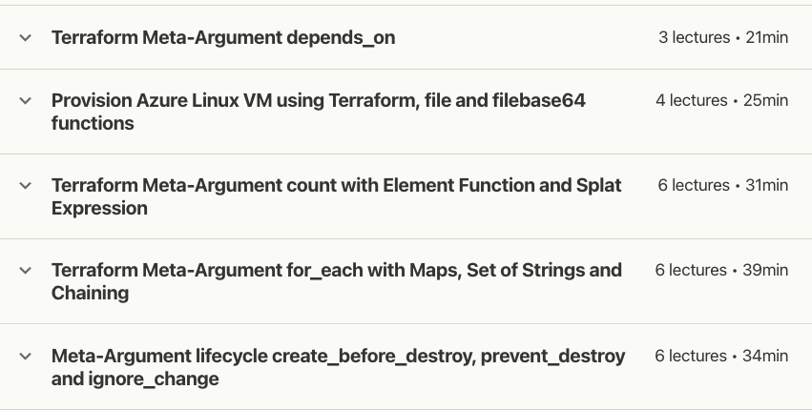
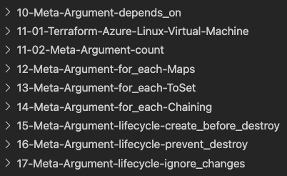
Practical Example with Step-by-Step Documentation on Github
Demos for
Meta-Arguments
Author: Nho Luong
Skill: DevOps Engineer Lead

Slide 95
Resource Meta-Arguments
depends_on
To handle hidden resource or module dependencies that Terraform can't automatically infer.
count
For creating multiple resource instances according to a count
for_each
To create multiple instances according to a map, or set of strings
provider
For selecting a non-default provider configuration
lifecycle
Standard Resource behavior can be altered using special nested lifecycle block within a resource block body
Provisioners & Connections
For taking extra actions after resource creation (Example: install some app on server or do something on local desktop after resource is created at remote destination)
Author: Nho Luong
Skill: DevOps Engineer Lead

Slide 96
Terraform
Resource
Meta-Argument
depends_on
Author: Nho Luong
Skill: DevOps Engineer Lead

Slide 97
Resource Meta-Arguments – depends_on
Use the depends_on meta-argument to handle hidden resource or module dependencies that Terraform can't automatically infer.
The depends_on meta-argument, if present, must be a list of references to other resources or child modules in the same calling module.
Resource
Meta-Argument
depends_on
Explicitly specifying a dependency is only necessary when a resource or module relies on some other resource's behavior but doesn't access any of that resource's data in its arguments.
Arbitrary expressions are not allowed in the depends_on argument value, because its value must be known before Terraform knows resource relationships and thus before it can safely evaluate expressions.
This argument is available in module blocks and in all resource blocks, regardless of resource type.
The depends_on argument should be used only as a last resort. Add comments for future reference about why we added this.
Author: Nho Luong
Skill: DevOps Engineer Lead

Slide 98
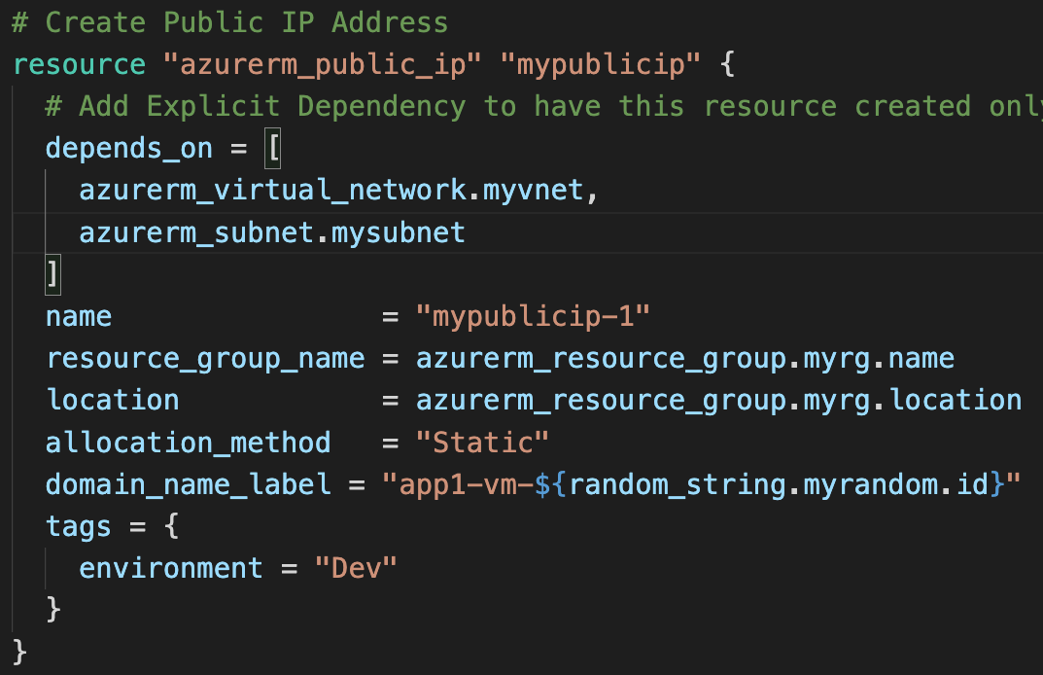
Use case: What are we going implement?
# Resource-1: Create Random String Resource
# Resource-2: Create Azure Resource Group
# Resource-3: Create Azure Virtual Network
# Resource-4: Create Azure Subnet
# Resource-5: Create Azure Public IP
# Resource-6: Create Azure Network Interface
# Resource-5: Create Azure Public IP only after VNET and Subnet got created using depends_on
Explicitly specifying a dependency is only necessary when a resource or module relies on some other resource's behavior but doesn't access any of that resource's data in its arguments.
Author: Nho Luong
Skill: DevOps Engineer Lead

Slide 99
Terraform
Resource
Meta-Argument
count
Author: Nho Luong
Skill: DevOps Engineer Lead

Slide 100

Resource Meta-Arguments – count
If a resource or module block includes a count argument whose value is a whole number, Terraform will create that many instances.
count.index: The distinct index number (starting with 0) corresponding to this instance.
Each instance has a distinct infrastructure object associated with it, and each is separately created, updated, or destroyed when the configuration is applied.
Resource
Meta-Argument
count
When count is set, Terraform distinguishes between the block itself and the multiple resource or module instances associated with it. Instances are identified by an index number, starting with 0.
The count meta-argument accepts numeric expressions. The count value must be known before Terraform performs any remote resource actions.
Module support for count was added in Terraform 0.13, and previous versions can only use it with resources.
A given resource or module block cannot use both count and for_each
Author: Nho Luong
Skill: DevOps Engineer Lead

Slide 101
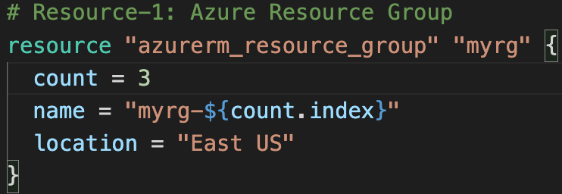
Use case: What are we going implement?
# Resource-1: Use Meta-Argument Count to create multiple Resource Groups using single Resource
count
count.index
azurerm_resource_group. myrg[0]
azurerm_resource_group. myrg
azurerm_resource_group. myrg[1]
Resource
Instances
azurerm_resource_group. myrg[2]
Author: Nho Luong
Skill: DevOps Engineer Lead

Slide 102
Terraform
Resource
Meta-Argument
for_each with Maps
Author: Nho Luong
Skill: DevOps Engineer Lead

Slide 103
Resource Meta-Arguments – for_each
If a resource or module block includes a for_each argument whose value is a map or a set of strings, Terraform will create one instance for each member of that map or set.
For set of Strings, each.key = each.value
for_each = toset( ["Jack", "James"] )
each.key = Jack
each.key = James
A given resource or module block cannot use both count and for_each
Resource
Meta-Argument
for_each
Each instance has a distinct infrastructure object associated with it, and each is separately created, updated, or destroyed when the configuration is applied.
For Maps, we use each.key & each.value for_each = {
dev = ”myapp1"
} each.key = dev each.value = myapp1
In blocks where for_each is set, an additional each object is available in expressions, so you can modify the configuration of each instance.
each.key — The map key (or set member) corresponding to this instance.
each.value — The map value corresponding to this instance. (If a set was provided, this is the same as each.key.)
Module support for for_each was added in Terraform 0.13, and previous versions can only use it with resources.
Author: Nho Luong
Skill: DevOps Engineer Lead

Slide 104
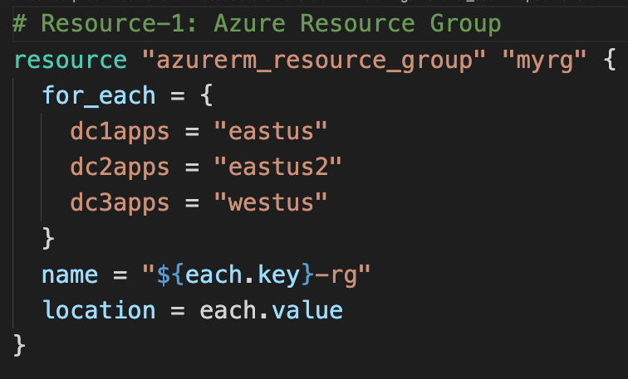
Usecase-1: for_each Maps
# Resource-1: Use Meta-Argument for_each with Maps to create multiple Resource Groups using single Resource
Define for_each with Map with Key Value pairs
Use each.key for Resource Group Name
Use each.value for Resource Group Location
Author: Nho Luong
Skill: DevOps Engineer Lead

Slide 105
Terraform
Resource
Meta-Argument
for_each with Set of Strings & toset function
Author: Nho Luong
Skill: DevOps Engineer Lead

Slide 106

Usecase-2: for_each Set of Strings (toset)
# Resource-1: Use Meta-Argument for_each with Set of Strings to create multiple Resource Groups using single Resource
Define for_each with Set of Strings
Use each.value for Resource Group Name
Use each.key for Resource Group Location
each.key == each.value
Author: Nho Luong
Skill: DevOps Engineer Lead

Slide 107
Terraform
Resource
Meta-Argument
for_each chaining
Author: Nho Luong
Skill: DevOps Engineer Lead

Slide 108
Terraform
Resource
Meta-Argument
lifecycle
Author: Nho Luong
Skill: DevOps Engineer Lead

Slide 109



Resource
Meta-Argument
lifecycle
lifecycle is a nested block that can appear within a resource block
The lifecycle block and its contents are meta-arguments, available for all resource blocks regardless of type.
create_before_destroy
prevent_destroy
ignore_changes
Author: Nho Luong
Skill: DevOps Engineer Lead

Slide 110
Terraform
Variables
Input Variables
Author: Nho Luong
Skill: DevOps Engineer Lead

Slide 111
Input variables serve as parameters for a Terraform module, allowing aspects of the module to be customized without altering the module's own source code, and allowing modules to be shared between different configurations.
Input Variables - Basics
1
Demos
6
Provide Input Variables using <any-name>.tfvars file with CLI
argument -var-file
Provide Input Variables when prompted during terraform plan or apply
2
7
Provide Input Variables using somefilename.auto.tfvars files
Terraform Input Variables
Override default variable values using CLI argument -var
3
8
Implement complex type constructors like List & Map in Input Variables
Override default variable values using Environment Variables (TF_var_aa)
9
Implement Custom Validation Rules in Variables
4
Provide Input Variables using terraform.tfvars files
5
10
Protect Sensitive Input Variables
13
Input Variables using
Structural Type: Object
11
Input Variables using
Collection Type: set
12
Input Variables using
Structural Type: tuple
Author: Nho Luong
Skill: DevOps Engineer Lead

Slide 112
Terraform
Variables
Output Values
Author: Nho Luong
Skill: DevOps Engineer Lead

Slide 113
Terraform Variables – Output Values
Output values are like the return values of a Terraform module and have several uses
A root module can use outputs to print certain values in the CLI output after running terraform apply.
A child module can use outputs to expose a subset of its resource attributes to a parent module.
1
Terraform Variables
Outputs
2
When using remote state, root module outputs can be accessed by other configurations via a terraform_remote_state data source.
Advanced
3
Author: Nho Luong
Skill: DevOps Engineer Lead

Slide 114
Output Values – 3 Demos
Demo-1
Demo-2
Demo-3
Basics
Count and Splat Expression
for_each and for loops
Over the process master the for loops in Terraform with Lists and Maps
Author: Nho Luong
Skill: DevOps Engineer Lead

Slide 115

Terraform Variables Output Values Basics
Author: Nho Luong
Skill: DevOps Engineer Lead

Slide 116

Terraform Variables Output Values Count and Splat Expression
Author: Nho Luong
Skill: DevOps Engineer Lead

Slide 117

Terraform Variables Output Values for_each and for loops with Lists
Author: Nho Luong
Skill: DevOps Engineer Lead

Slide 118

Terraform Variables Output Values for_each and for loops with Maps
Author: Nho Luong
Skill: DevOps Engineer Lead

Slide 119

Terraform Variables Output Values for_each and for loops with keys() and values() functions
Author: Nho Luong
Skill: DevOps Engineer Lead

Slide 120


Practical Example with Step-by-Step Documentation on Github
Author: Nho Luong
Skill: DevOps Engineer Lead

Slide 121
Terraform
Variables
Local Values
Author: Nho Luong
Skill: DevOps Engineer Lead

Slide 122
DRY Principle
Don’t Repeat Yourself
Author: Nho Luong
Skill: DevOps Engineer Lead

Slide 123



Terraform Variables – Local Values
A local value assigns a name to an expression, so you can use that name multiple times within a module without repeating it.
Local values are like a function's temporary local variables.
Once a local value is declared, you can reference it in expressions as local.<NAME>.
Local values can be helpful to avoid repeating the same values or expressions multiple times in a configuration
If overused they can also make a configuration hard to read by future maintainers by hiding the actual values used
The ability to easily change the value in a central place is the key advantage of local values.
In short, Use local values only in moderation
Author: Nho Luong
Skill: DevOps Engineer Lead

Slide 124

Terraform Variables – Local Values
Author: Nho Luong
Skill: DevOps Engineer Lead

Slide 125
Practical Example with Step-by-Step Documentation on Github
Author: Nho Luong
Skill: DevOps Engineer Lead

Slide 126
Terraform
Datasources
Author: Nho Luong
Skill: DevOps Engineer Lead

Slide 127

Terraform Datasources
Data sources allow data to be fetched or computed for use elsewhere in Terraform configuration.
Use of data sources allows a Terraform configuration to make use of information defined outside of Terraform, or defined by another separate Terraform configuration.
A data source is accessed via a special kind of resource known as a data resource, declared using a data block
Each data resource is associated with a single data source, which determines the kind of object (or objects) it reads and what query constraint arguments are available
Data resources have the same dependency resolution behavior as defined for managed resources. Setting the depends_on meta-argument within data blocks defers reading of the data source until after all changes to the dependencies have been applied.
Author: Nho Luong
Skill: DevOps Engineer Lead

Slide 128
Terraform Datasources
Meta-Arguments for Datasources
Data resources support the provider meta-argument as defined for managed resources, with the same syntax and behavior.
Data resources do not currently have any customization settings available for their lifecycle, but the lifecycle nested block is reserved in case any are added in future versions.
Data resources support count and for_each meta-arguments as defined for managed resources, with the same syntax and behavior.
Each instance will separately read from its data source with its own variant of the constraint arguments, producing an indexed result.
Author: Nho Luong
Skill: DevOps Engineer Lead

Slide 129
Terraform
Backend
Remote State Storage
Author: Nho Luong
Skill: DevOps Engineer Lead

Slide 130
What is Terraform Backend ?
Backends are responsible for storing state and providing an API for state locking.
Terraform State Storage
Terraform State Locking
Azure Storage Account
Author: Nho Luong
Skill: DevOps Engineer Lead

Slide 131
Local State File
Remote State File
Admin1
Admin2
Admin3
Multiple Team members
cannot update the infrastructure as they don’t have access to State File
Using Terraform Backend concept we can use Azure SA as the shared storage for State Files
Admin1
Admin2
Admin3
Admin1
Desktop
Admin2
Desktop
Admin3
Desktop
This means we need store the state file in a shared location.
If two team members are running Terraform at the same time, you may run into race conditions as multiple Terraform processes make concurrent updates to the state files, leading to conflicts, data loss, and state file corruption.
Admin1
Desktop
Azure
Storage Account
terraform.tfstate
terraform.tfstate
Azure VM
Instance
Azure VM
Instance
Azure Cloud
State Locking
Azure Cloud
Author: Nho Luong
Skill: DevOps Engineer Lead

Slide 132
Terraform Remote State File with State Locking
Admin1
Admin2
Admin3
Not all backends support State Locking. Azure Storage Account supports State Locking
State locking happens automatically on all operations that could write state.
Admin1
Desktop
Admin2
Desktop
Admin3
Desktop
If state locking fails, Terraform will not continue.
You can disable state locking for most commands with the -lock flag but it is not recommended.
Azure Storage Account
terraform.tfstate
If acquiring the lock is taking longer than expected, Terraform will output a status message.
If Terraform doesn't output a message, state locking is still occurring if your backend supports it.
Azure VM
Instance
Terraform has a force-unlock command to manually unlock the state if unlocking failed.
Azure Cloud
Author: Nho Luong
Skill: DevOps Engineer Lead

Slide 133

Terraform Remote State File with State Locking
Terraform Remote State Storage
Author: Nho Luong
Skill: DevOps Engineer Lead

Slide 134
Terraform
Backends
Author: Nho Luong
Skill: DevOps Engineer Lead

Slide 135
Terraform Backends
Each Terraform configuration can specify a backend, which defines where and how operations are performed, where state snapshots are stored, etc.
Where Backends are Used
Backend configuration is only used by Terraform CLI.
Terraform Cloud and Terraform Enterprise always use their own state storage when performing Terraform runs, so they ignore any backend block in the configuration.
For Terraform Cloud users also it is always recommended to use backend block in Terraform configuration for commands like terraform taint which can be executed only using Terraform CLI
Author: Nho Luong
Skill: DevOps Engineer Lead

Slide 136
Terraform Backends
What Backends Do
There are two things backends will be used for
Where state is stored
Where operations are performed.
Store State
State Locking
Operations
Terraform uses persistent state data to keep track of the resources it manages.
State Locking is to prevent conflicts and inconsistencies when the operations are being performed
"Operations" refers to performing API requests against infrastructure services in order to create, read, update, or destroy resources.
Everyone working with a given collection of infrastructure resources must be able to access the same state data (shared state storage).
Not every terraform subcommand performs API operations; many of them only operate on state data.
What are Operations ?
terraform apply
terraform destroy
Only two backends actually perform operations: local and remote.
The remote backend can perform API operations remotely, using Terraform Cloud or Terraform Enterprise.
Author: Nho Luong
Skill: DevOps Engineer Lead

Slide 137
Terraform Backends
Backend Types
Enhanced Backends
Standard Backends
Enhanced backends can both store state and perform operations. There are only two enhanced backends: local and remote
Standard backends only store state, and rely on the local backend for performing operations.
Example for Remote Backend Performing Operations : Terraform Cloud, Terraform Enterprise
Example: AWS S3, Azure RM, Consul, etcd, gcs http and many more
Author: Nho Luong
Skill: DevOps Engineer Lead

Slide 138
Terraform
Remote State
Datasource
Author: Nho Luong
Skill: DevOps Engineer Lead

Slide 139
Terraform Remote State Datasource
The terraform_remote_state data source retrieves the root module output values from some other Terraform configuration, using the latest state snapshot from the remote backend.
Project-1
Project-2
Azure Resource Group
Virtual Network
Azure Linux Virtual Machine
terraform_remote_state data source
project-1/terraform.tfstate
project-2/terraform.tfstate
Author: Nho Luong
Skill: DevOps Engineer Lead

Slide 140


Terraform Backend – Both Projects
Project-1 Terraform State File
Project-2 Terraform State File
Author: Nho Luong
Skill: DevOps Engineer Lead

Slide 141

Terraform Remote State Datasource – Used in Project-2
Author: Nho Luong
Skill: DevOps Engineer Lead

Slide 142

Reference Project-1 Output Values in Project -2
Author: Nho Luong
Skill: DevOps Engineer Lead

Slide 143


Practical Example with Step-by-Step Documentation on Github
Project-1 Terraform Configuration Files
Project-2 Terraform Configuration Files
Author: Nho Luong
Skill: DevOps Engineer Lead

Slide 144
Terraform
State Commands
Author: Nho Luong
Skill: DevOps Engineer Lead

Slide 145
Terraform Commands – State Perspective
terraform show
terraform
force-unlock
terraform apply refresh-only
Terraform
Commands
terraform taint
terraform plan
terraform untaint
terraform state
terraform
apply target
Author: Nho Luong
Skill: DevOps Engineer Lead

Slide 146
Terraform
Workspaces
Author: Nho Luong
Skill: DevOps Engineer Lead

Slide 147
Terraform Workspaces – CLI based
Terraform starts with a single workspace named "default"
A common use for multiple workspaces is to create a parallel, distinct copy of a set of infrastructure in order to test a set of changes before modifying the main production infrastructure.
This workspace is special both because it is the default and also because it cannot ever be deleted.
For example, a developer working on a complex set of infrastructure changes might create a new temporary workspace in order to freely experiment with changes without affecting the default workspace
By default, we are working in default workspace
Terraform will not recommend using workspaces for larger infrastructures inline with environments pattern like dev, qa, staging. Recommended to use separate configuration directories
Named workspaces allow conveniently switching between multiple instances of a single configuration within its single backend.
Terraform CLI workspaces are completed different from Terraform Cloud Workspaces
They are convenient in a number of situations, but cannot solve all problems.
Author: Nho Luong
Skill: DevOps Engineer Lead

Slide 148
Terraform Workspace Commands
terraform workspace show
terraform workspace list
Terraform Workspace Commands
terraform workspace new
terraform workspace select
terraform workspace delete
Usecase-1: Local Backend
Usecase-2: Remote Backend
Author: Nho Luong
Skill: DevOps Engineer Lead

Slide 149


Practical Example with Step-by-Step Documentation on Github
Author: Nho Luong
Skill: DevOps Engineer Lead

Slide 150
Terraform
Provisioners
Author: Nho Luong
Skill: DevOps Engineer Lead

Slide 151
Terraform Provisioners
Provisioners can be used to model specific actions on the local machine or on a remote machine in order to prepare servers
Passing data into virtual machines and other compute resources
Provisioners are a Last Resort
Running configuration management software (packer, chef, ansible)
First-class Terraform provider functionality may be available
Creation-Time Provisioners
Destroy-Time Provisioners
Failure Behaviour: Continue: Ignore the error and continue with creation or destruction.
Failure Behaviour: Fail: Raise an error and stop applying (the default behavior). If creation provisioner, taint resource
Author: Nho Luong
Skill: DevOps Engineer Lead

Slide 152
Types of Provisioners
File Provisioner
Provisioner Types
remote-exec Provisioner
local-exec Provisioner
Author: Nho Luong
Skill: DevOps Engineer Lead

Slide 153

Connection Block
Most provisioners require access to the remote resource via SSH or WinRM, and expect a nested connection block with details about how to connect.
Expressions in connection blocks cannot refer to their parent resource by name. Instead, they can use the special self object.
Author: Nho Luong
Skill: DevOps Engineer Lead

Slide 154

File Provisioner
File Provisioner
File Provisioner is used to copy files or directories from the machine executing Terraform to the newly created resource.
The file provisioner supports both ssh and winrm type of connections
Author: Nho Luong
Skill: DevOps Engineer Lead

Slide 155

local-exec Provisioner
local-exec Provisioner
The local-exec provisioner invokes a local executable after a resource is created.
This invokes a process on the machine running Terraform, not on the resource.
Creation Time Provisioner (by default)
Destroy Time Provisioner (when = destroy)
Author: Nho Luong
Skill: DevOps Engineer Lead

Slide 156

remote-exec Provisioner
remote-exec Provisioner
The remote-exec provisioner invokes a script on a remote resource after it is created.
This can be used to run a configuration management tool, bootstrap into a cluster, etc.
Author: Nho Luong
Skill: DevOps Engineer Lead

Slide 157

Null-Resource & Provisioners
null_resource
If you need to run provisioners that aren't directly associated with a specific resource, you can associate them with a null_resource.
Instances of null_resource are treated like normal resources, but they don't do anything.
Same as other resource, you can configure provisioners and connection details on a null_resource.
Author: Nho Luong
Skill: DevOps Engineer Lead

Slide 158

Null-Resource & Provisioners
Author: Nho Luong
Skill: DevOps Engineer Lead

Slide 159

Null-Resource & Provisioners
Author: Nho Luong
Skill: DevOps Engineer Lead

Slide 160


Practical Examples & Step-by-Step Documentation on Github
Author: Nho Luong
Skill: DevOps Engineer Lead

Slide 161
Terraform
Modules
Author: Nho Luong
Skill: DevOps Engineer Lead

Slide 162
Terraform Modules
Modules are containers for multiple resources that are used together. A module consists of a collection of .tf files kept together in a directory.
Modules are the main way to package and reuse resource configurations with Terraform.
A module that has been called by another module is often referred to as a child module.
Every Terraform configuration has at least one module, known as its root module, which consists of the resources defined in the .tf files in the main working directory
Child modules can be called multiple times within the same configuration, and multiple configurations can use the same child module.
A Terraform module (usually the root module of a configuration) can call other modules to include their resources into the configuration.
In addition to modules from the local filesystem, Terraform can load modules from a public or private registry.
This makes it possible to publish modules for others to use, and to use modules that others have published.
Author: Nho Luong
Skill: DevOps Engineer Lead

Slide 163
Terraform Registry – Use Publicly Available Modules
The Terraform Registry hosts a broad collection of publicly available Terraform modules for configuring many kinds of common infrastructure.
Demo
These modules are free to use, and Terraform can download them automatically if you specify the appropriate source and version in a module call block.
Author: Nho Luong
Skill: DevOps Engineer Lead

Slide 164
Build manually and then automate using Terraform
1. Build a Static Website using Azure manually using Azure Portal.
2. Automate it using Terraform Resources
Demo
Author: Nho Luong
Skill: DevOps Engineer Lead

Slide 165
Build a Local Terraform Module
Demo
Build a Local Terraform Module and call it from Root Module and Test
Author: Nho Luong
Skill: DevOps Engineer Lead

Slide 166

Publish to Public Terraform Registry
Demo
Publish to Public Terraform Registry and Access it from Public Registry and Test.
Author: Nho Luong
Skill: DevOps Engineer Lead

Slide 167

Use various Module Sources
Demo
In addition to Terraform Public and Private Registry use various module sources.
Author: Nho Luong
Skill: DevOps Engineer Lead

Slide 168

Private Module Registry in Terraform Cloud & Enterprise
Members of your organization might produce modules specifically crafted for your own infrastructure needs.
Terraform Cloud and Terraform Enterprise both include a private module registry for sharing modules internally within your organization.
Demo
Author: Nho Luong
Skill: DevOps Engineer Lead

Slide 169


Practical Examples & Step-by-Step Documentation on Github
Author: Nho Luong
Skill: DevOps Engineer Lead

Slide 170
Terraform
Cloud
Author: Nho Luong
Skill: DevOps Engineer Lead

Slide 171
Terraform Cloud
Or
Terraform Enterprise
Terraform Cloud and Terraform Enterprise are different distributions of the same application
It manages Terraform runs in a consistent and reliable environment, and includes easy access to shared state and secret data, access controls for approving changes to infrastructure, a private registry for sharing Terraform modules, detailed policy controls for governing the contents of Terraform configurations
Terraform Cloud is available as a hosted service at https://app.terraform.io.
They offer free accounts for small teams, and paid plans with additional feature sets for medium-sized businesses.
Large enterprises can purchase Terraform Enterprise, their self-hosted distribution of Terraform Cloud.
Author: Nho Luong
Skill: DevOps Engineer Lead

Slide 172
Terraform VCS-Driven Workflow
Terraform CLI-Driven Workflow
Check-in TF Files
Github
terraform plan
Local
Desktop
terraform apply
Developer
Developer
Triggers Terraform
Runs
Runs on Terraform Cloud
Terraform
Cloud
Author: Nho Luong
Skill: DevOps Engineer Lead

Slide 173
Publish Private Module Registry in Terraform Cloud
Check-in Private Module
Files
Github
Developer
Integrate it in
TF Cloud Modules
Terraform
Cloud
Author: Nho Luong
Skill: DevOps Engineer Lead

Slide 174

Practical Examples with Step-by-Step Github Documentation
Author: Nho Luong
Skill: DevOps Engineer Lead

Slide 175

Terraform Pricing
https://www.hashicorp.com/products/terraform/pricing
Author: Nho Luong
Skill: DevOps Engineer Lead

Slide 176
Terraform
Cloud
Version Control Workflow
Author: Nho Luong
Skill: DevOps Engineer Lead

Slide 177
Terraform VCS Integration
Terraform Cloud is more powerful when you integrate it with your version control system (VCS) provider (Github, Bitbucket, Gitlab).
Terraform Cloud can automatically initiate Terraform runs
Check-in TF Files
Github
Developer
Terraform Cloud makes code review easier by automatically predicting how pull requests will affect infrastructure.
Triggers Terraform
Runs
Publishing new versions of a private Terraform module is as easy as pushing a tag to the module's repository.
Terraform
Cloud
Author: Nho Luong
Skill: DevOps Engineer Lead

Slide 178

Terraform Cloud – Supported VCS Providers
https://www.terraform.io/docs/cloud/vcs/index.html
Author: Nho Luong
Skill: DevOps Engineer Lead

Slide 179

Terraform Cloud – Overview Tab
Author: Nho Luong
Skill: DevOps Engineer Lead

Slide 180

Terraform Cloud – Runs Tab
Author: Nho Luong
Skill: DevOps Engineer Lead

Slide 181


Terraform Cloud – States Tab
Author: Nho Luong
Skill: DevOps Engineer Lead

Slide 182

Terraform Cloud – Variables Tab
Environment Variables
defined with
Azure Client ID and Secret to Connect to Azure Cloud
Author: Nho Luong
Skill: DevOps Engineer Lead

Slide 183

Terraform Cloud Settings Tab
Author: Nho Luong
Skill: DevOps Engineer Lead

Slide 184
Terraform
Cloud
Private Module
Registry
Author: Nho Luong
Skill: DevOps Engineer Lead

Slide 185
Terraform Private Module Registry
Terraform Cloud's private module registry helps you share Terraform modules across your organization.
It includes support for module versioning, a searchable and filterable list of available modules, and a configuration designer to help you build new workspaces faster.
Check-in Private Module
Files
Github
Developer
Publish Module
on Terraform Cloud
By design, the private module registry works much like the public Terraform Registry. If you're already used the public registry, Terraform Cloud's registry will feel familiar.
Terraform
Cloud
Author: Nho Luong
Skill: DevOps Engineer Lead

Slide 186

Terraform Cloud – Private Module Registry
Author: Nho Luong
Skill: DevOps Engineer Lead

Slide 187

Terraform Cloud – Private Module Registry
Author: Nho Luong
Skill: DevOps Engineer Lead

Slide 188
Terraform
Cloud
CLI Driven Workflow
Author: Nho Luong
Skill: DevOps Engineer Lead

Slide 189
Terraform Cloud - CLI Driven Workflow
The CLI-driven run workflow uses Terraform's standard CLI tools to execute runs in Terraform Cloud.
The Terraform remote backend brings Terraform Cloud's collaboration features into the familiar Terraform CLI workflow
terraform plan
Local
Desktop
terraform apply
Users can start runs with the standard terraform plan and terraform apply commands, and can watch the progress of the run without leaving their terminal.
terraform destroy
Developer
Runs on Terraform Cloud
These runs execute remotely in Terraform Cloud; they use variables from the appropriate workspace, enforce any applicable Sentinel policies, and can access Terraform Cloud's private module registry and remote state inputs.
We can maintain track of apply and destroy plans on TF Cloud
Terraform
Cloud
Author: Nho Luong
Skill: DevOps Engineer Lead

Slide 190

Terraform Cloud - CLI Driven Workflow
Terraform
Cloud as
Backend configured in
Terraform Block
Author: Nho Luong
Skill: DevOps Engineer Lead

Slide 191

Terraform Cloud - CLI Driven Workflow
Author: Nho Luong
Skill: DevOps Engineer Lead

Slide 192


Terraform Cloud - CLI Driven Workflow
Author: Nho Luong
Skill: DevOps Engineer Lead

Slide 193

Terraform Cloud - CLI Driven Workflow – States Tab
Author: Nho Luong
Skill: DevOps Engineer Lead

Slide 194
Terraform
Cloud
Sentinel
Author: Nho Luong
Skill: DevOps Engineer Lead

Slide 195
What is Sentinel ?
Sentinel is an embedded policy-as-code framework integrated with the HashiCorp Enterprise products.
It enables fine-grained, logic-based policy decisions, and can be extended to use information from external sources.
Author: Nho Luong
Skill: DevOps Engineer Lead

Slide 196

Sentinel Policies
Sentinel Policies
Author: Nho Luong
Skill: DevOps Engineer Lead

Slide 197

Sentinel Enforcement Mode - Advisory
Author: Nho Luong
Skill: DevOps Engineer Lead

Slide 198

Sentinel Enforcement Mode – Soft-Mandatory
Author: Nho Luong
Skill: DevOps Engineer Lead

Slide 199

Sentinel Enforcement Mode – Hard-Mandatory
Author: Nho Luong
Skill: DevOps Engineer Lead

Slide 200

Sentinel – CIS Policies
Author: Nho Luong
Skill: DevOps Engineer Lead

Slide 201



Practical Examples with Step-by-Step Github Documentation
Author: Nho Luong
Skill: DevOps Engineer Lead

Slide 202

Thank You
Author: Nho Luong
Skill: DevOps Engineer Lead

